Slide 1
THE SCIENCE OF ART
THE ART OF SCIENCE
Mandy Root-Thompson: MedDraw Studio

Slide 2

ABOUT
I work with medical and scientific professionals to communicate complex medical and surgical procedures in a beautiful and easy to understand format.
patient education
editorial illustrations
journal figures
My background is in advertising, marketing, education, and biological and anatomical sciences.

Slide 3
ORDER FROM CHAOS

Slide 4
ORDER FROM CHAOS
Communicating with your audience

Slide 5
ORDER FROM CHAOS
Communicating with your audience
Communicating with your medical illustrator

Slide 6
AUDIENCE
WHO
Know who your audience is
WHAT
Know what you are trying to communicate
PRIORITIZE
Prioritize the key ideas you want to communicate
OMIT
What you leave out is just as important as what you include

Slide 7
ILLUSTRATOR
Your manuscript
Medical imaging
Scientific
Illustration
Your sketches!
Reference images

Slide 8
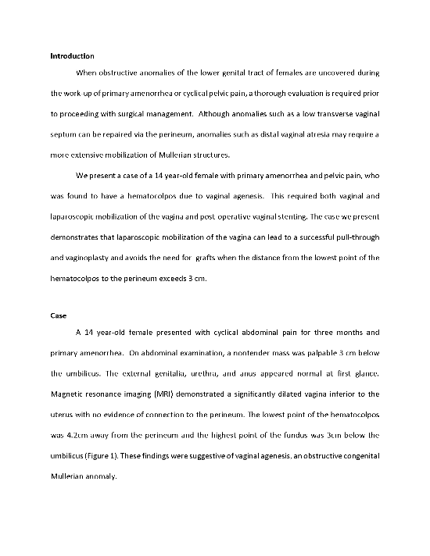
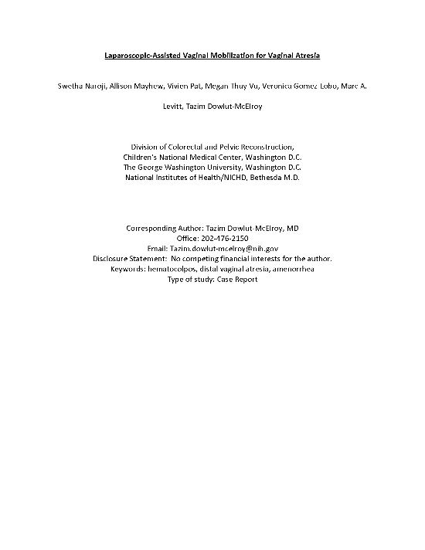
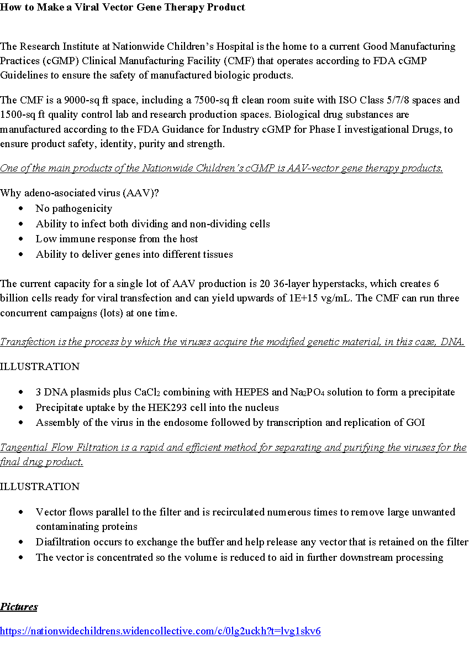
YOUR
MANUSCRIPT

Slide 9
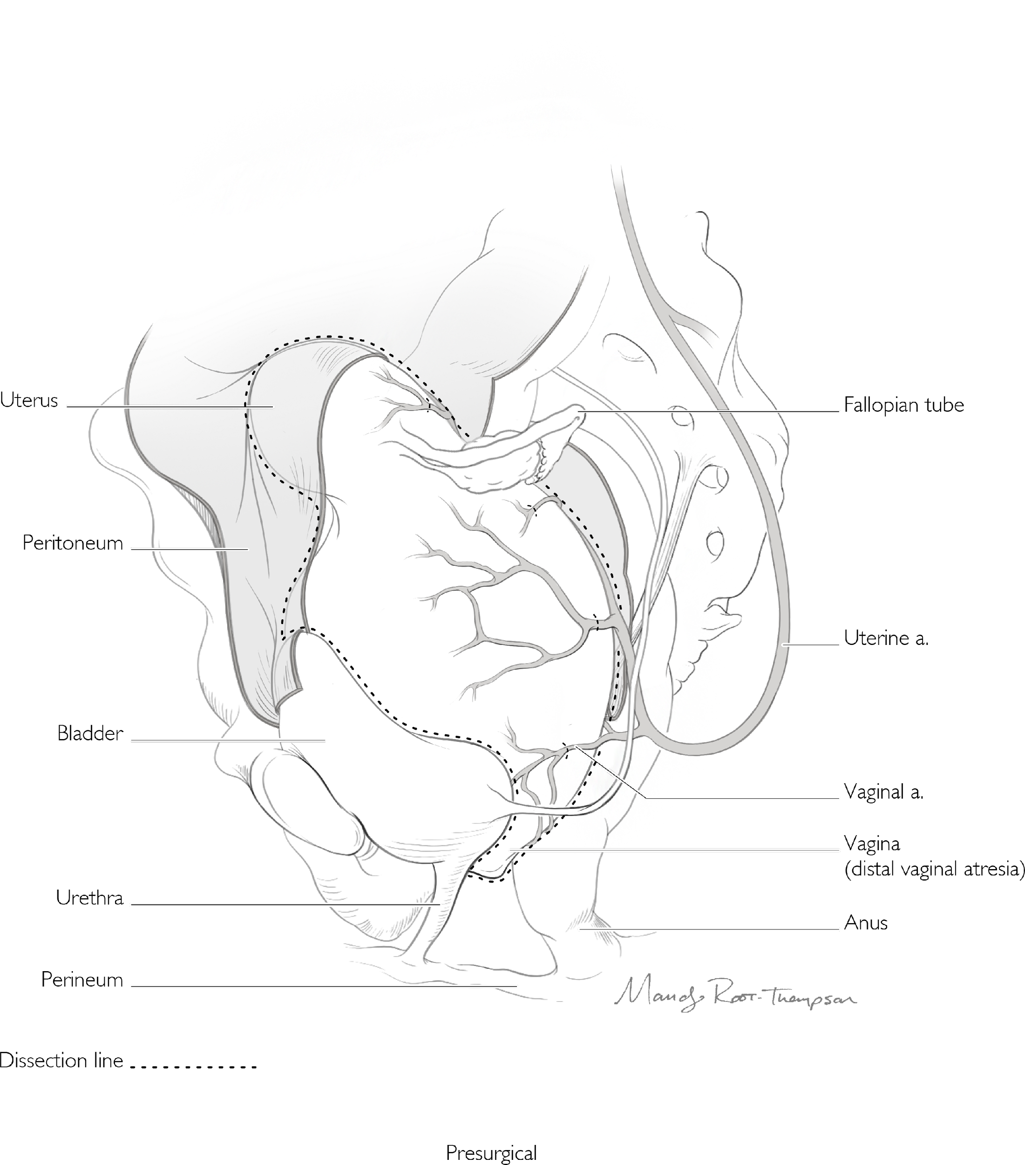
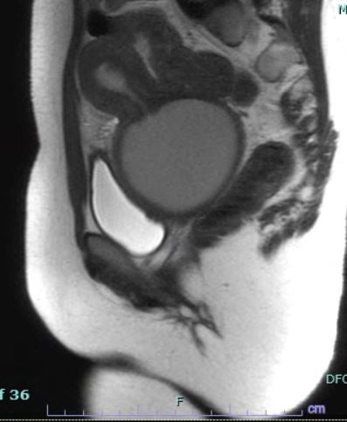
MEDICAL IMAGING

Slide 10

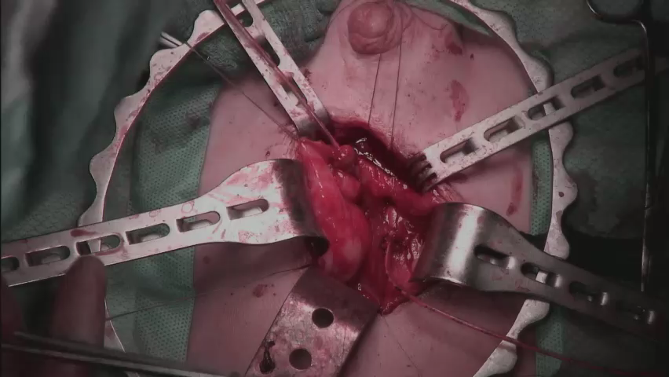
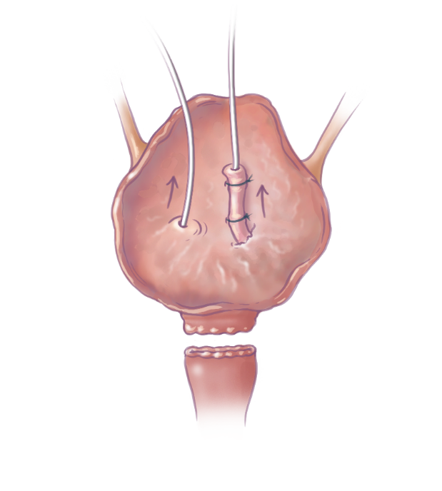
MEDICAL IMAGING

Slide 11
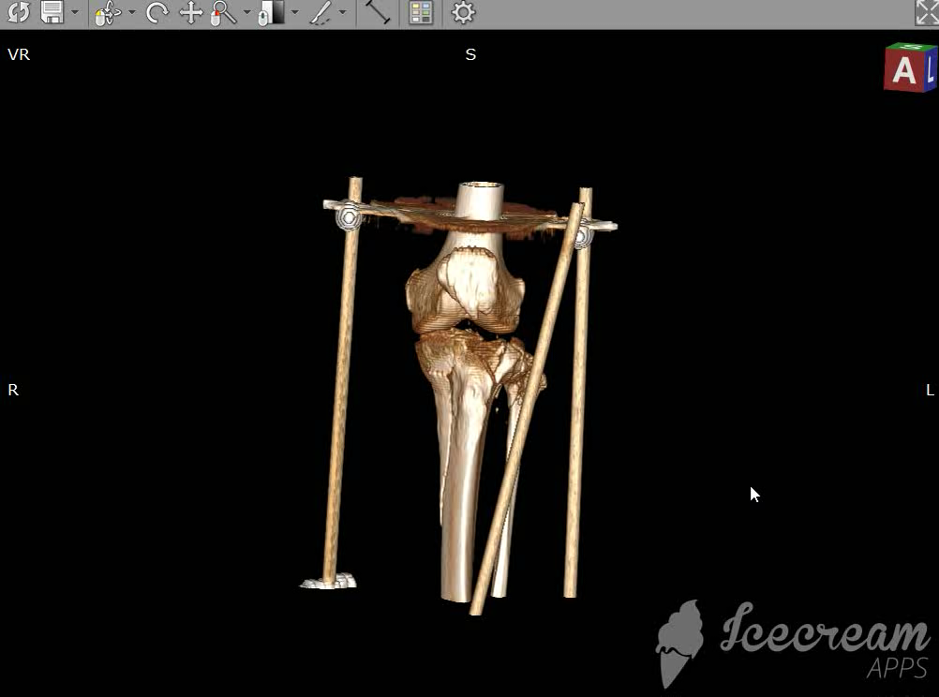
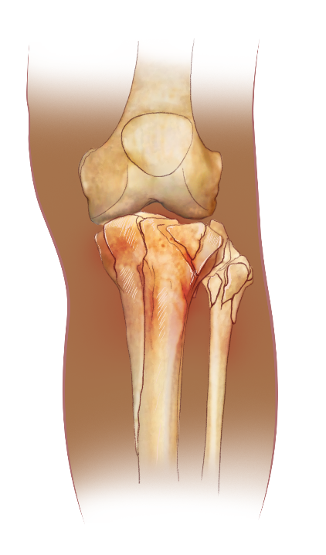
MEDICAL IMAGING

Slide 12
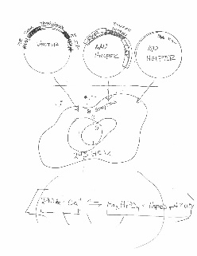
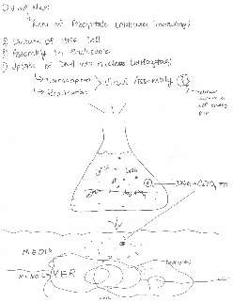
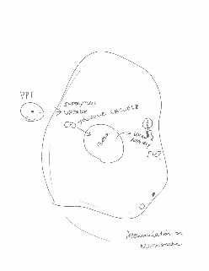
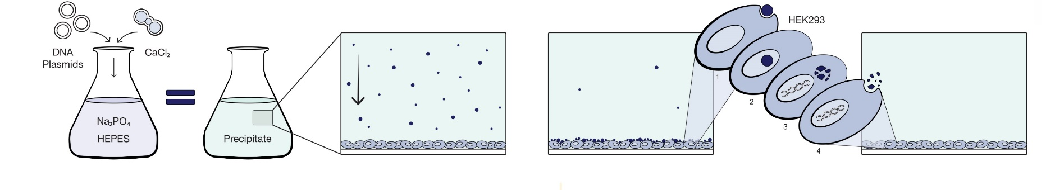
YOUR SKETCHES

Slide 13
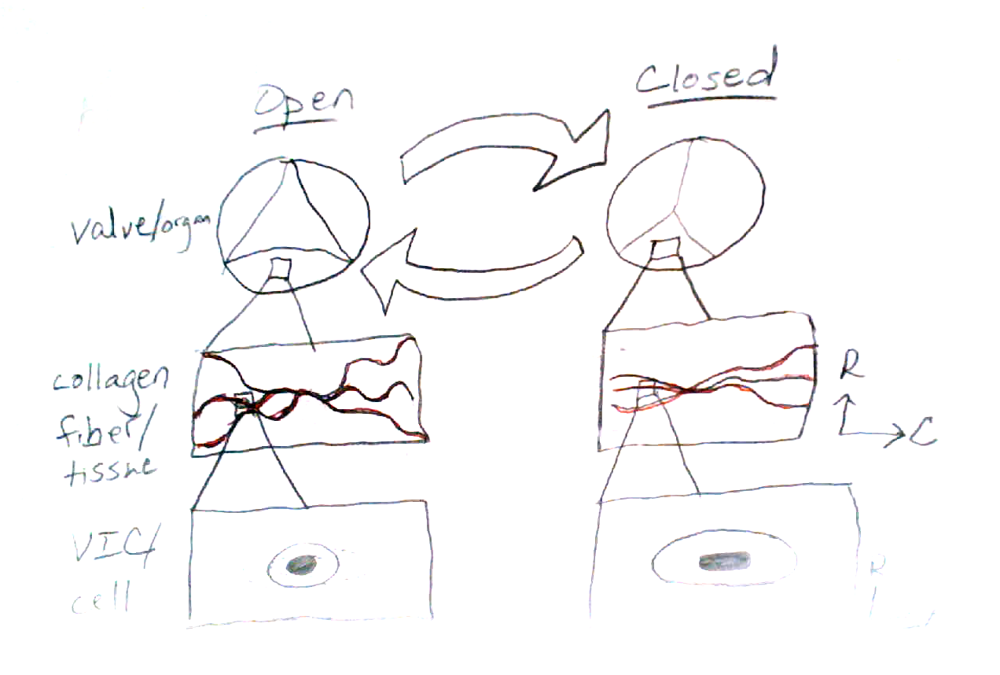
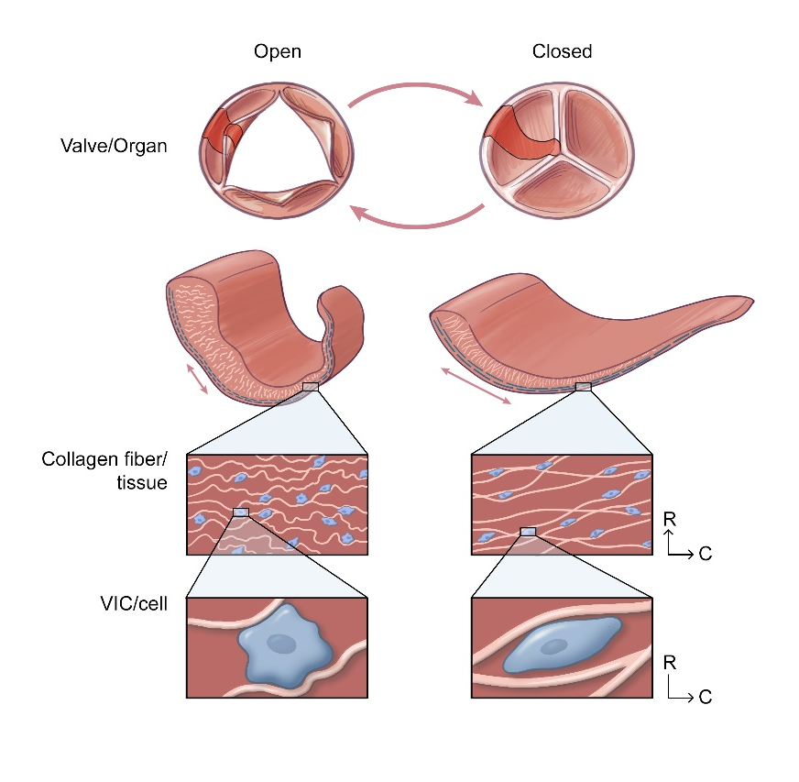
YOUR SKETCHES

Slide 14
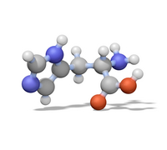
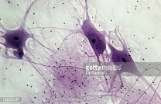
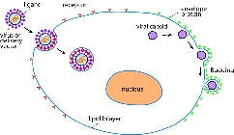

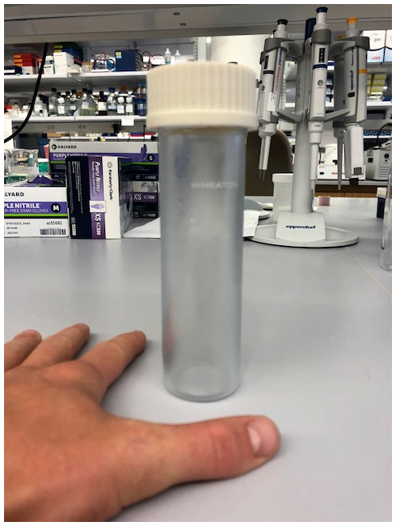
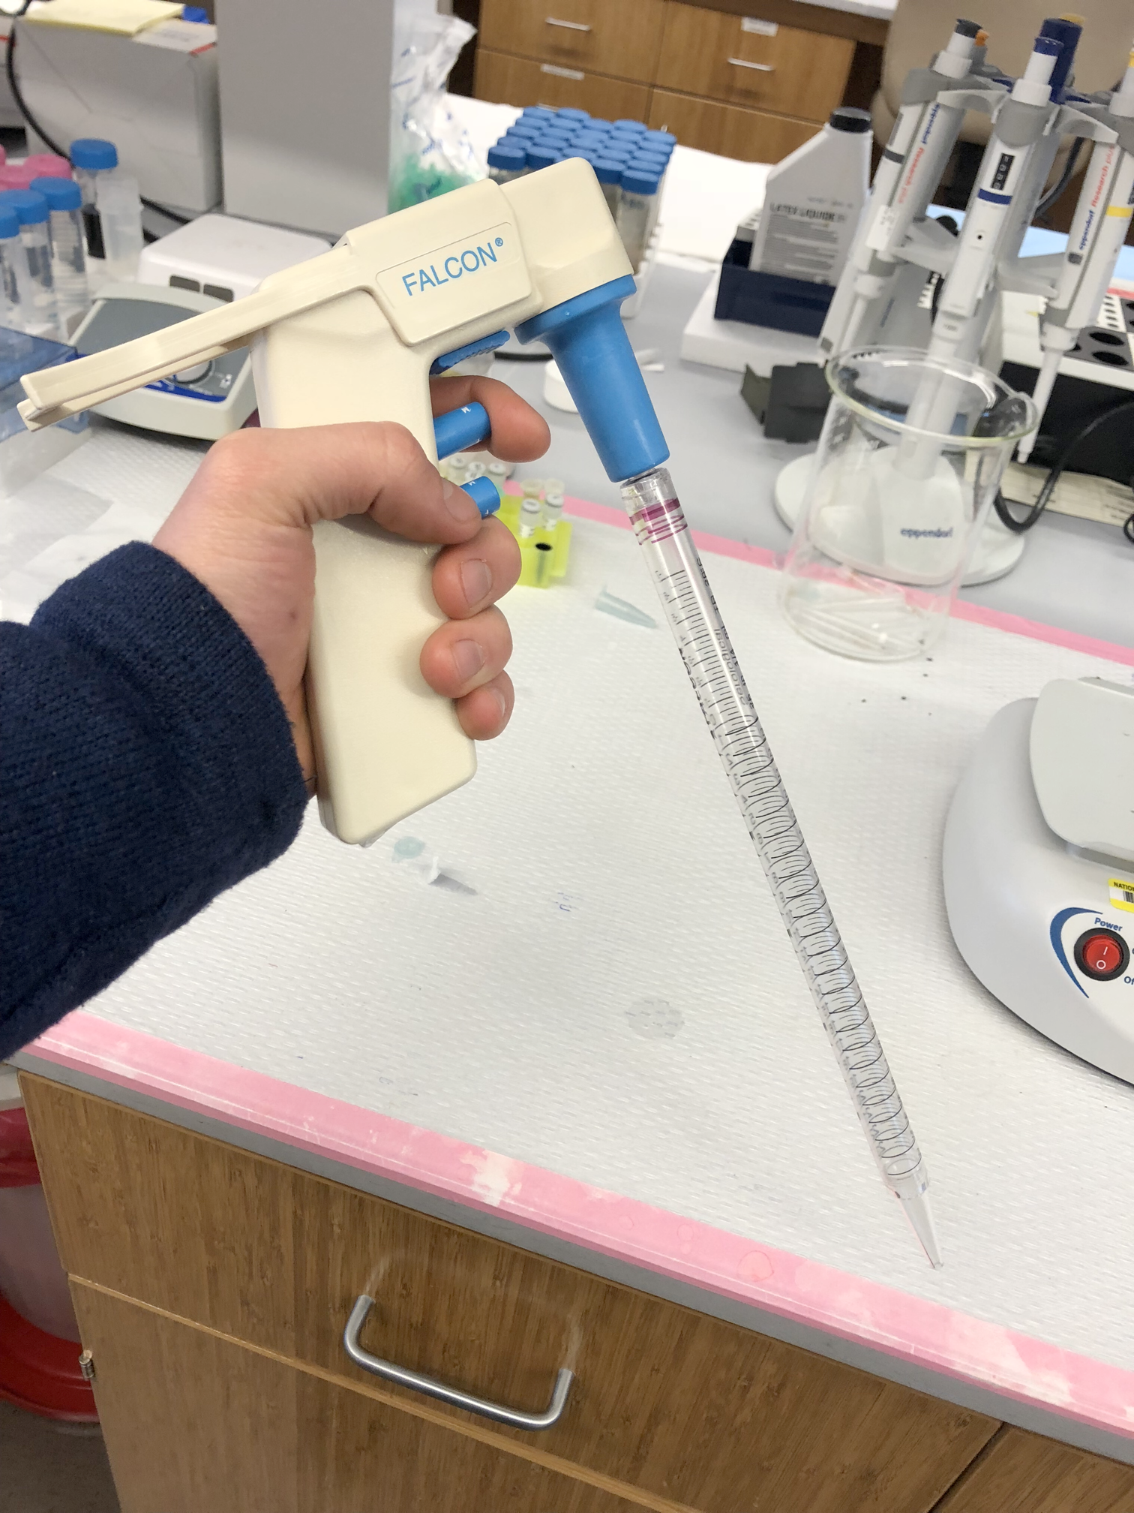
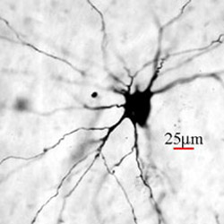
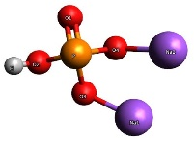
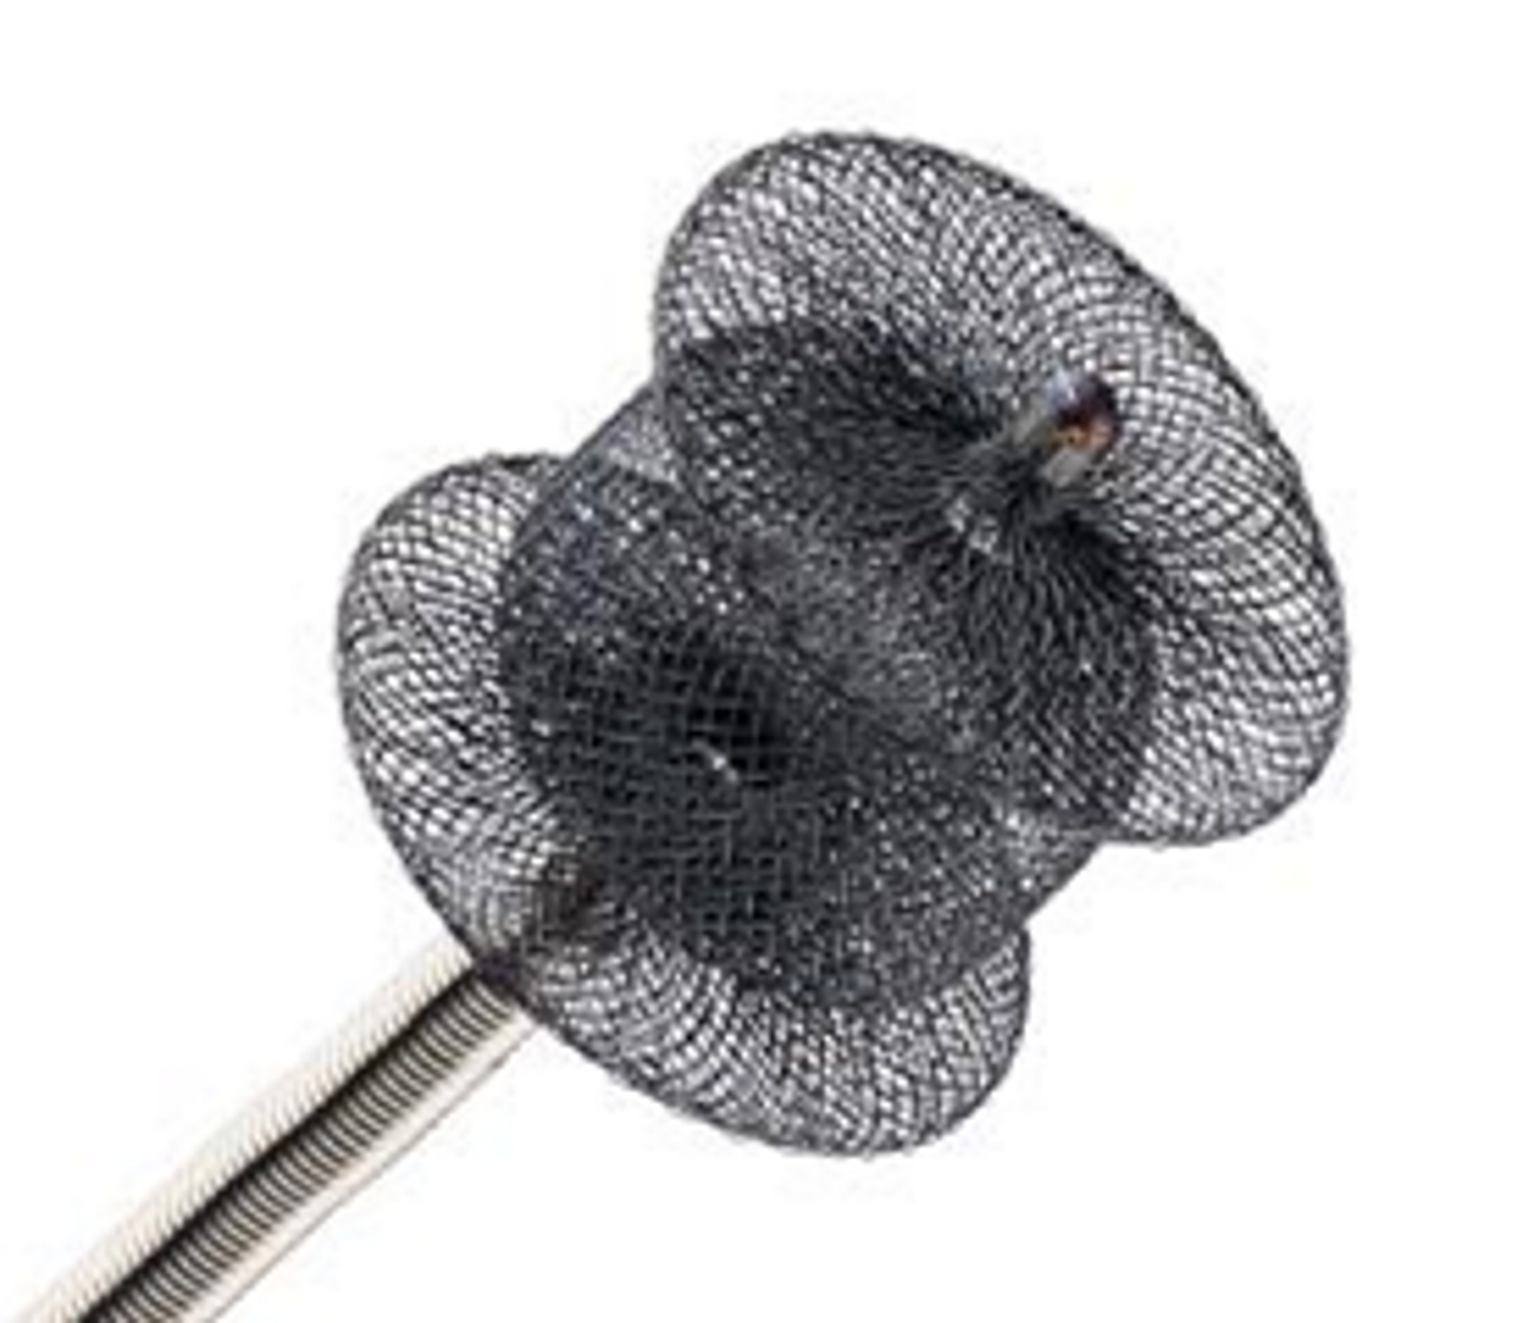
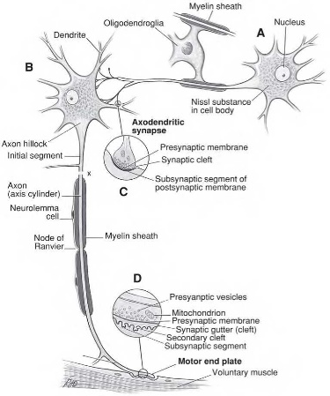
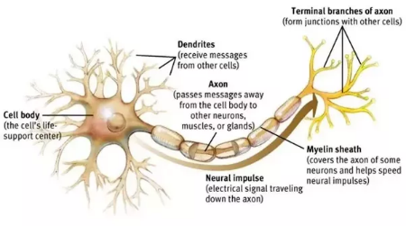
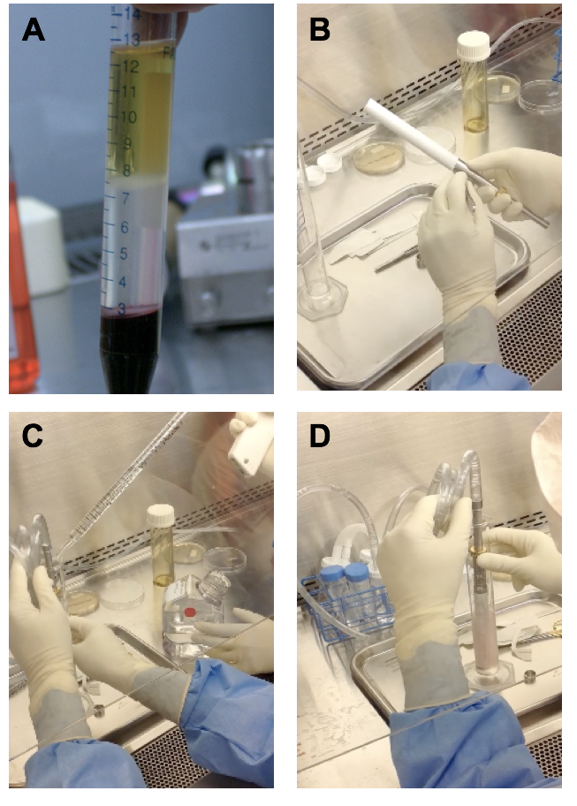
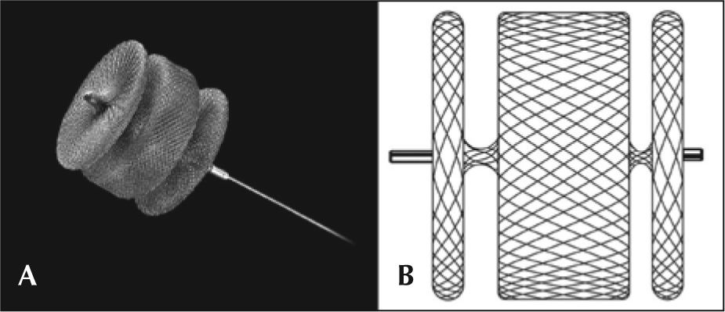
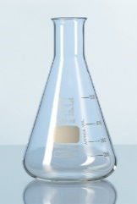

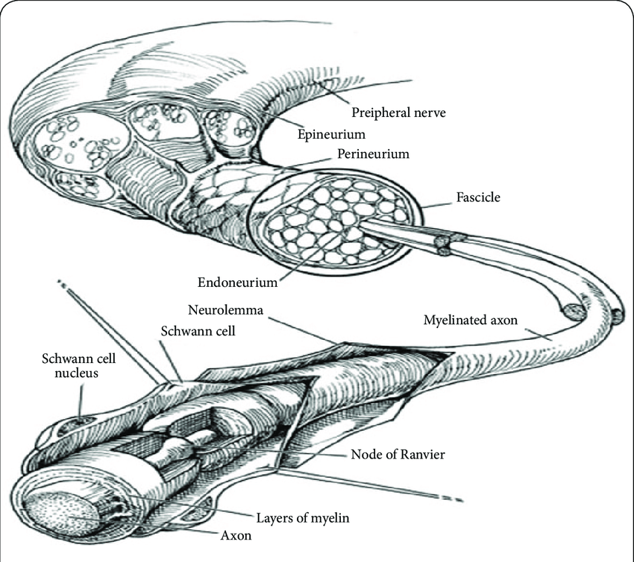
REFERENCE IMAGES

Slide 15
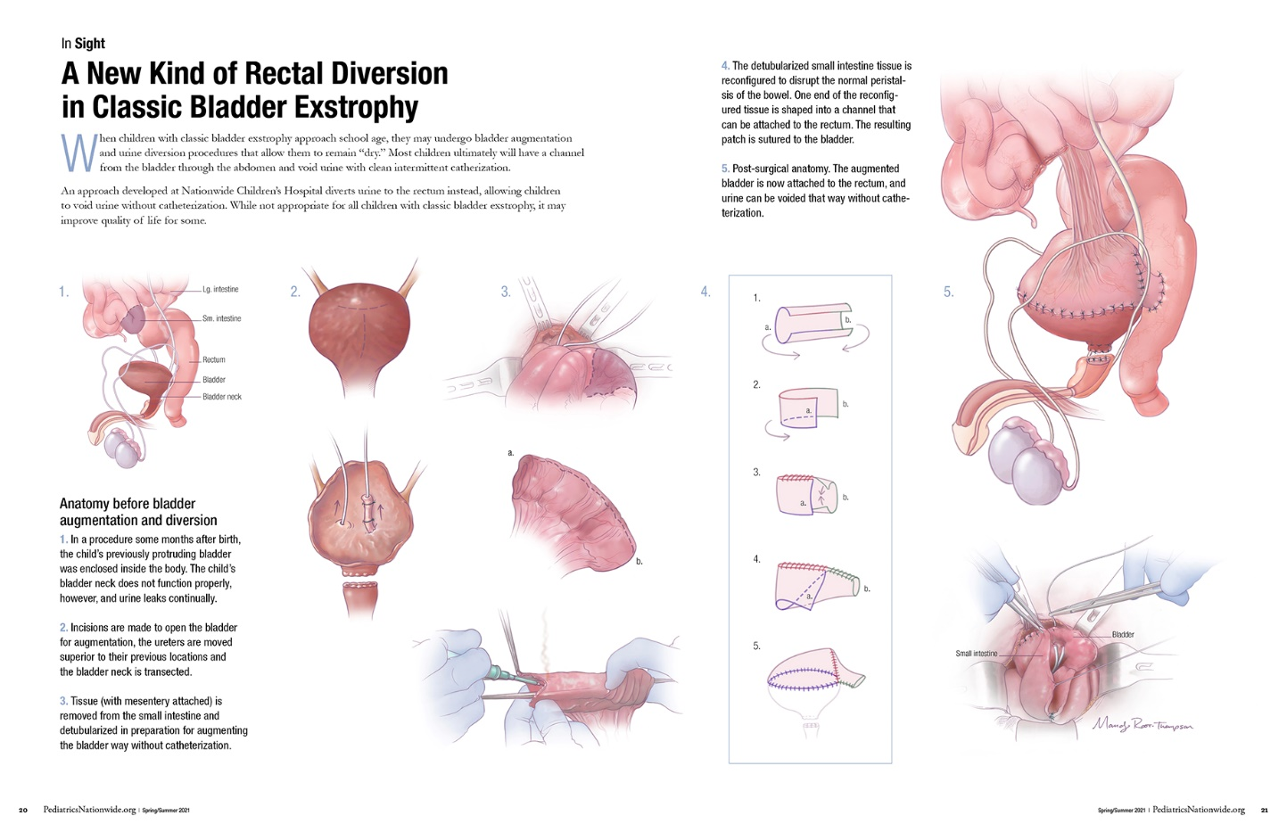
PROJECT OVERVIEW
Rectal Diversion and Bladder Exstrophy – Doctor Rama Jayanthi, Nationwide Children’s Hospital

Slide 16
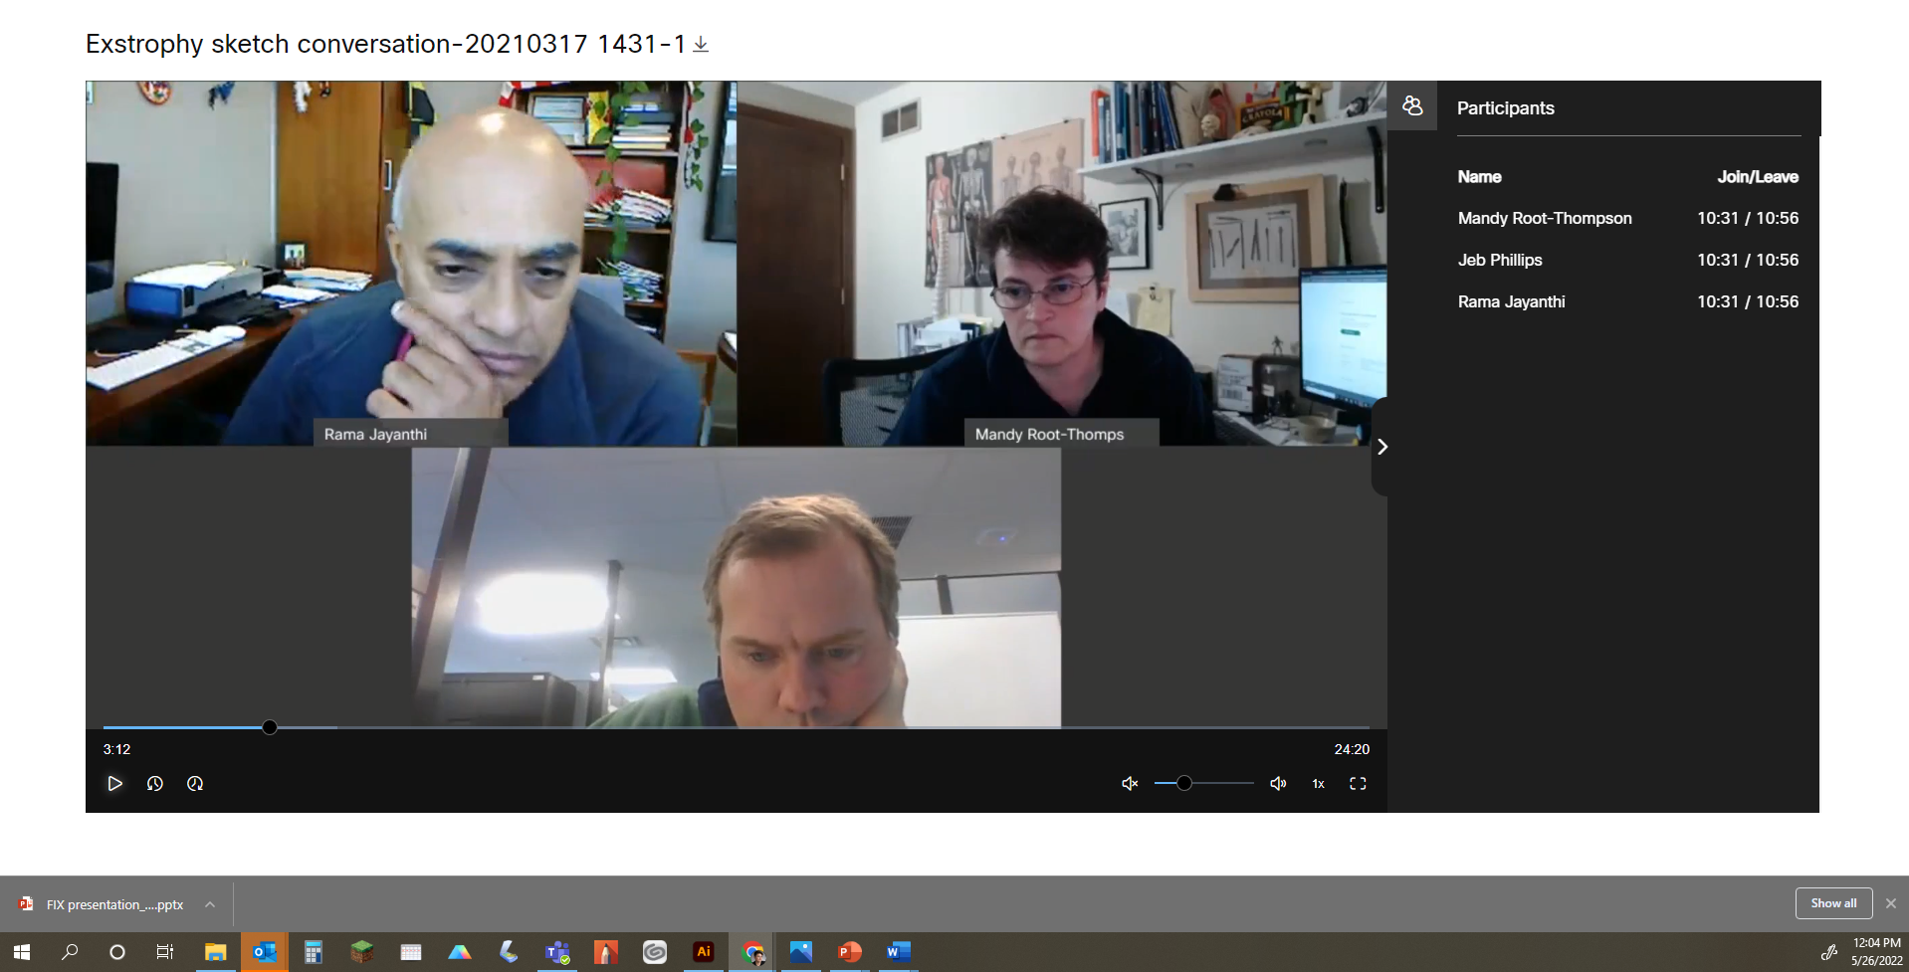
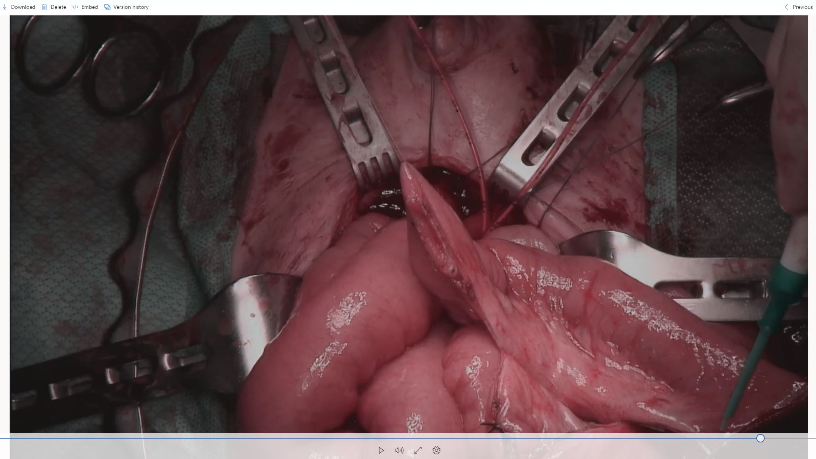
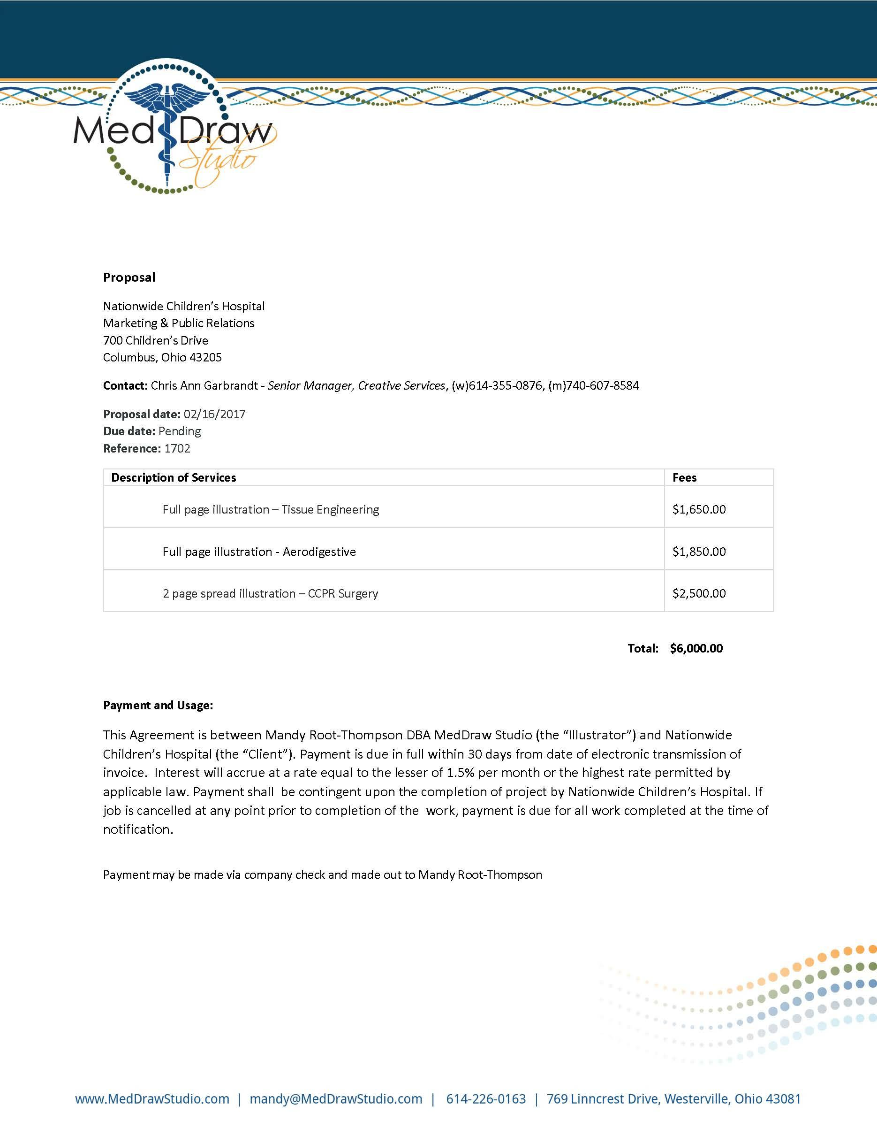
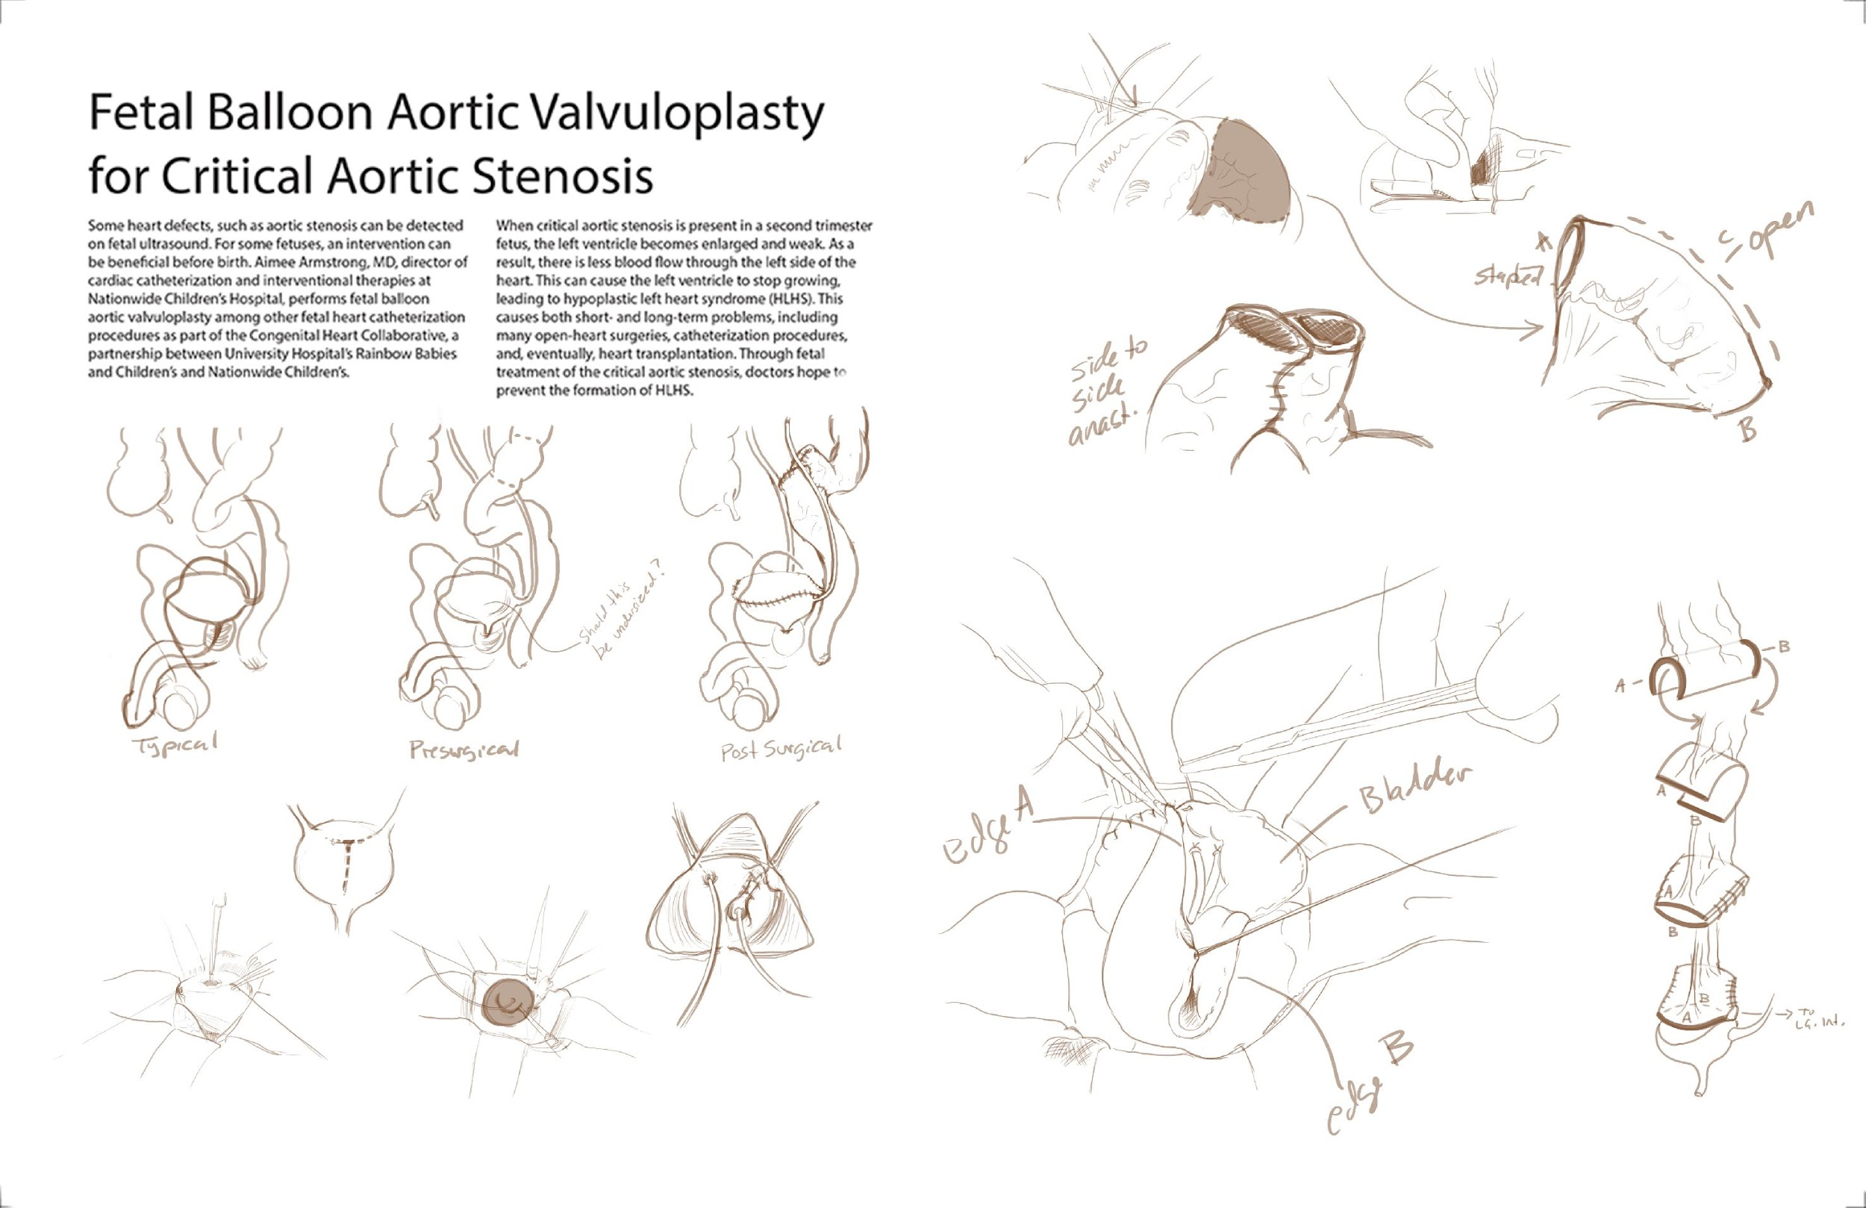
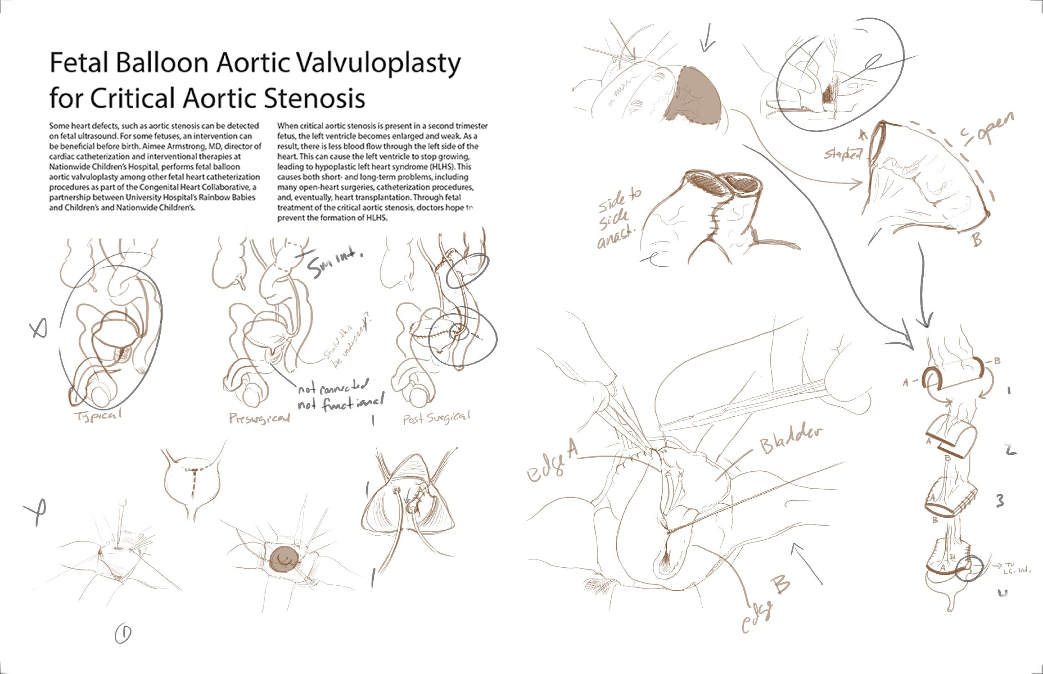
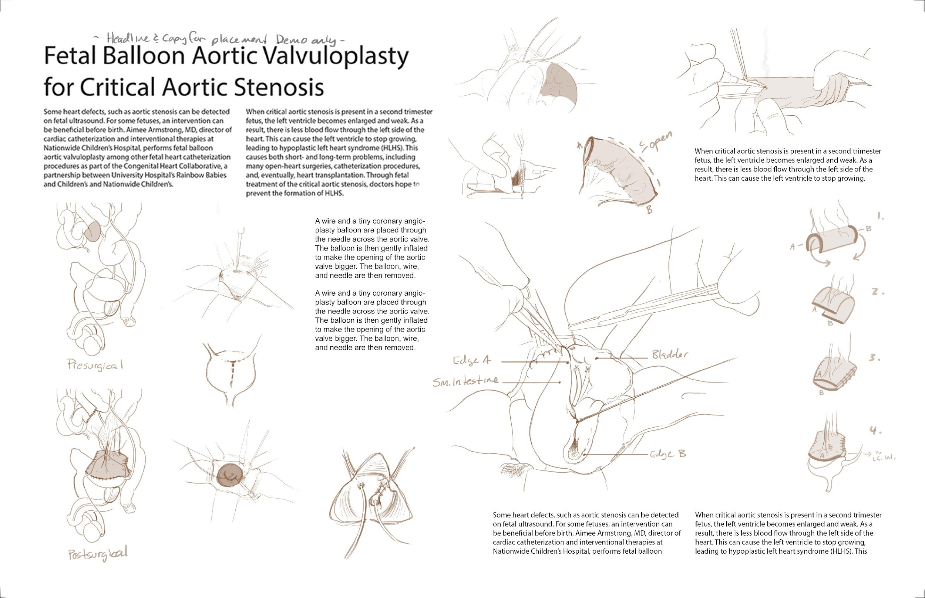
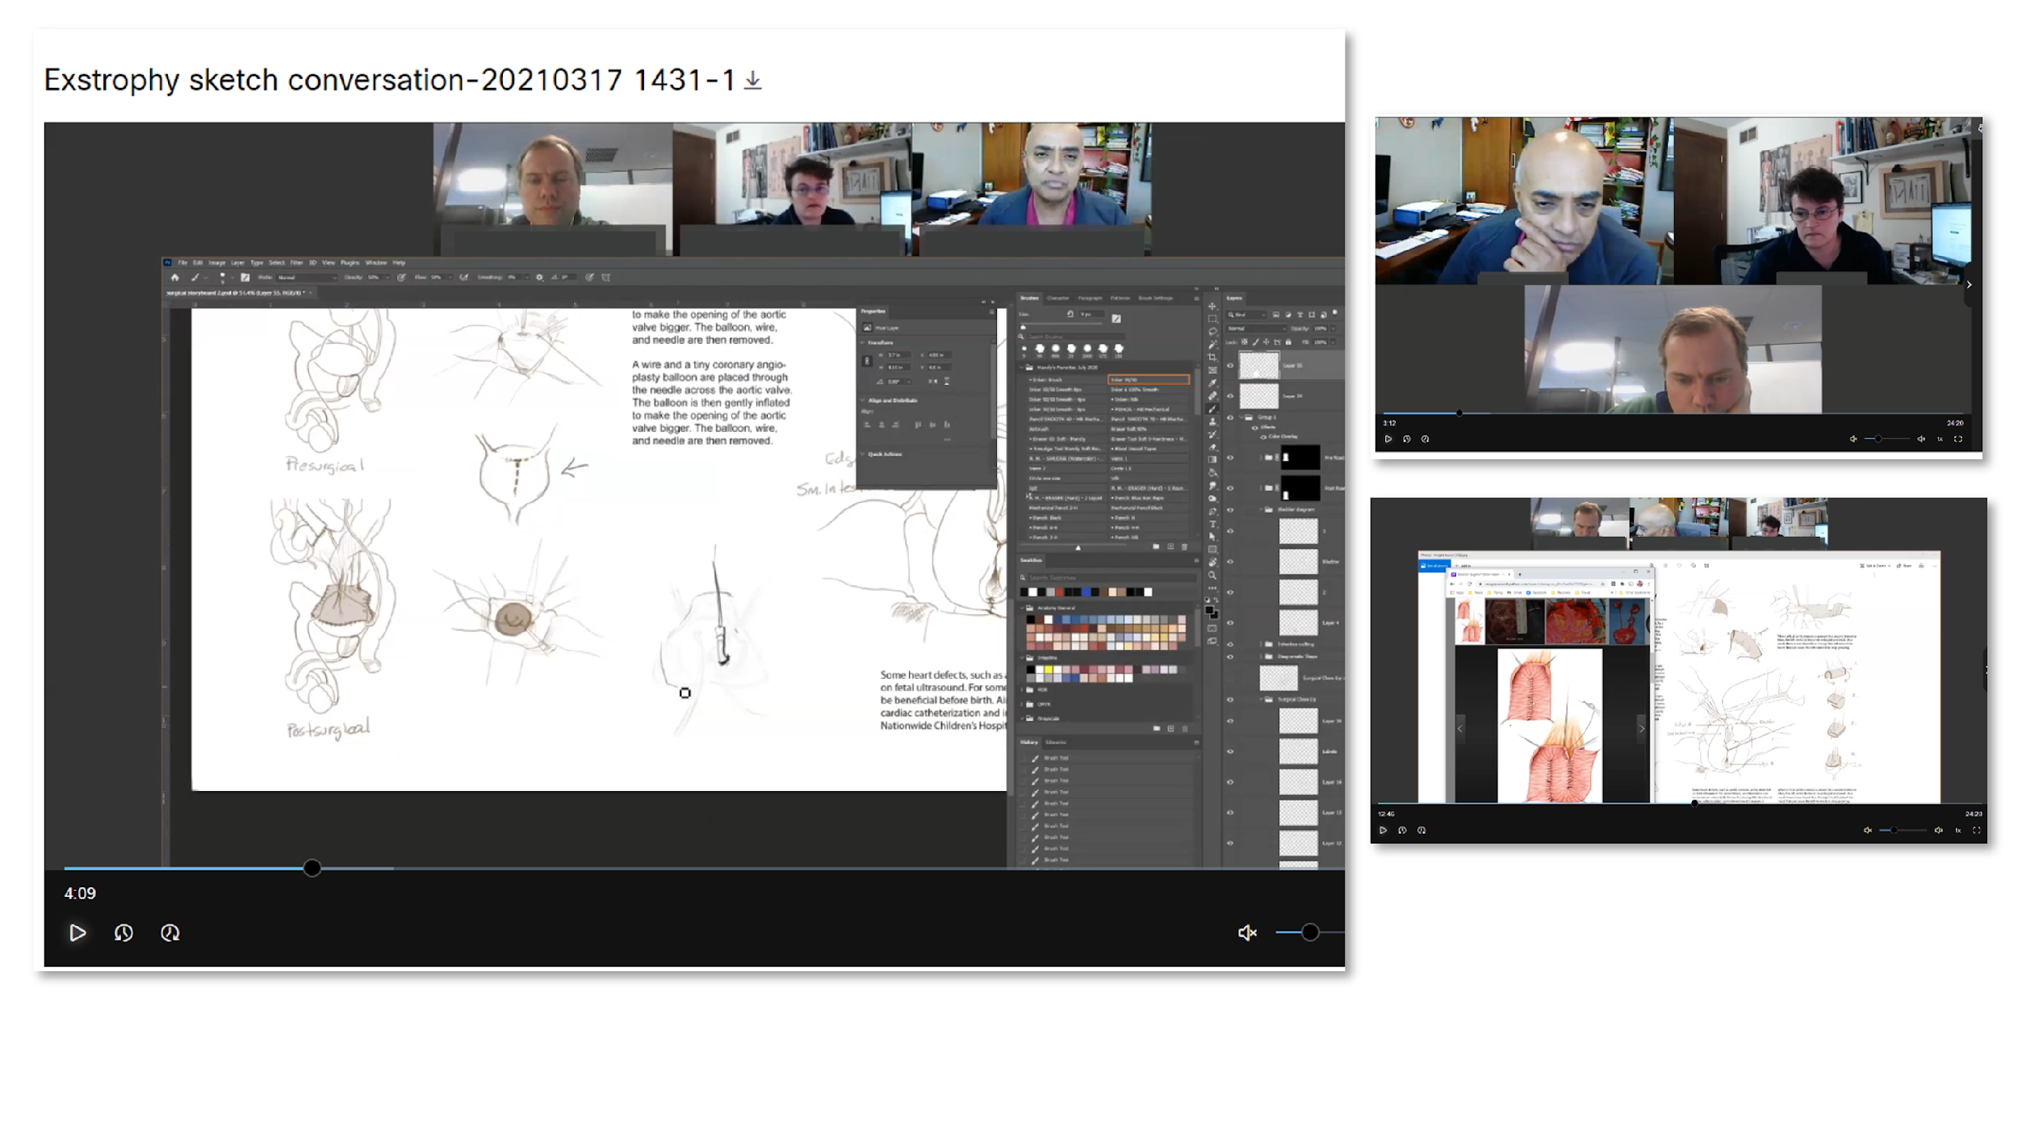
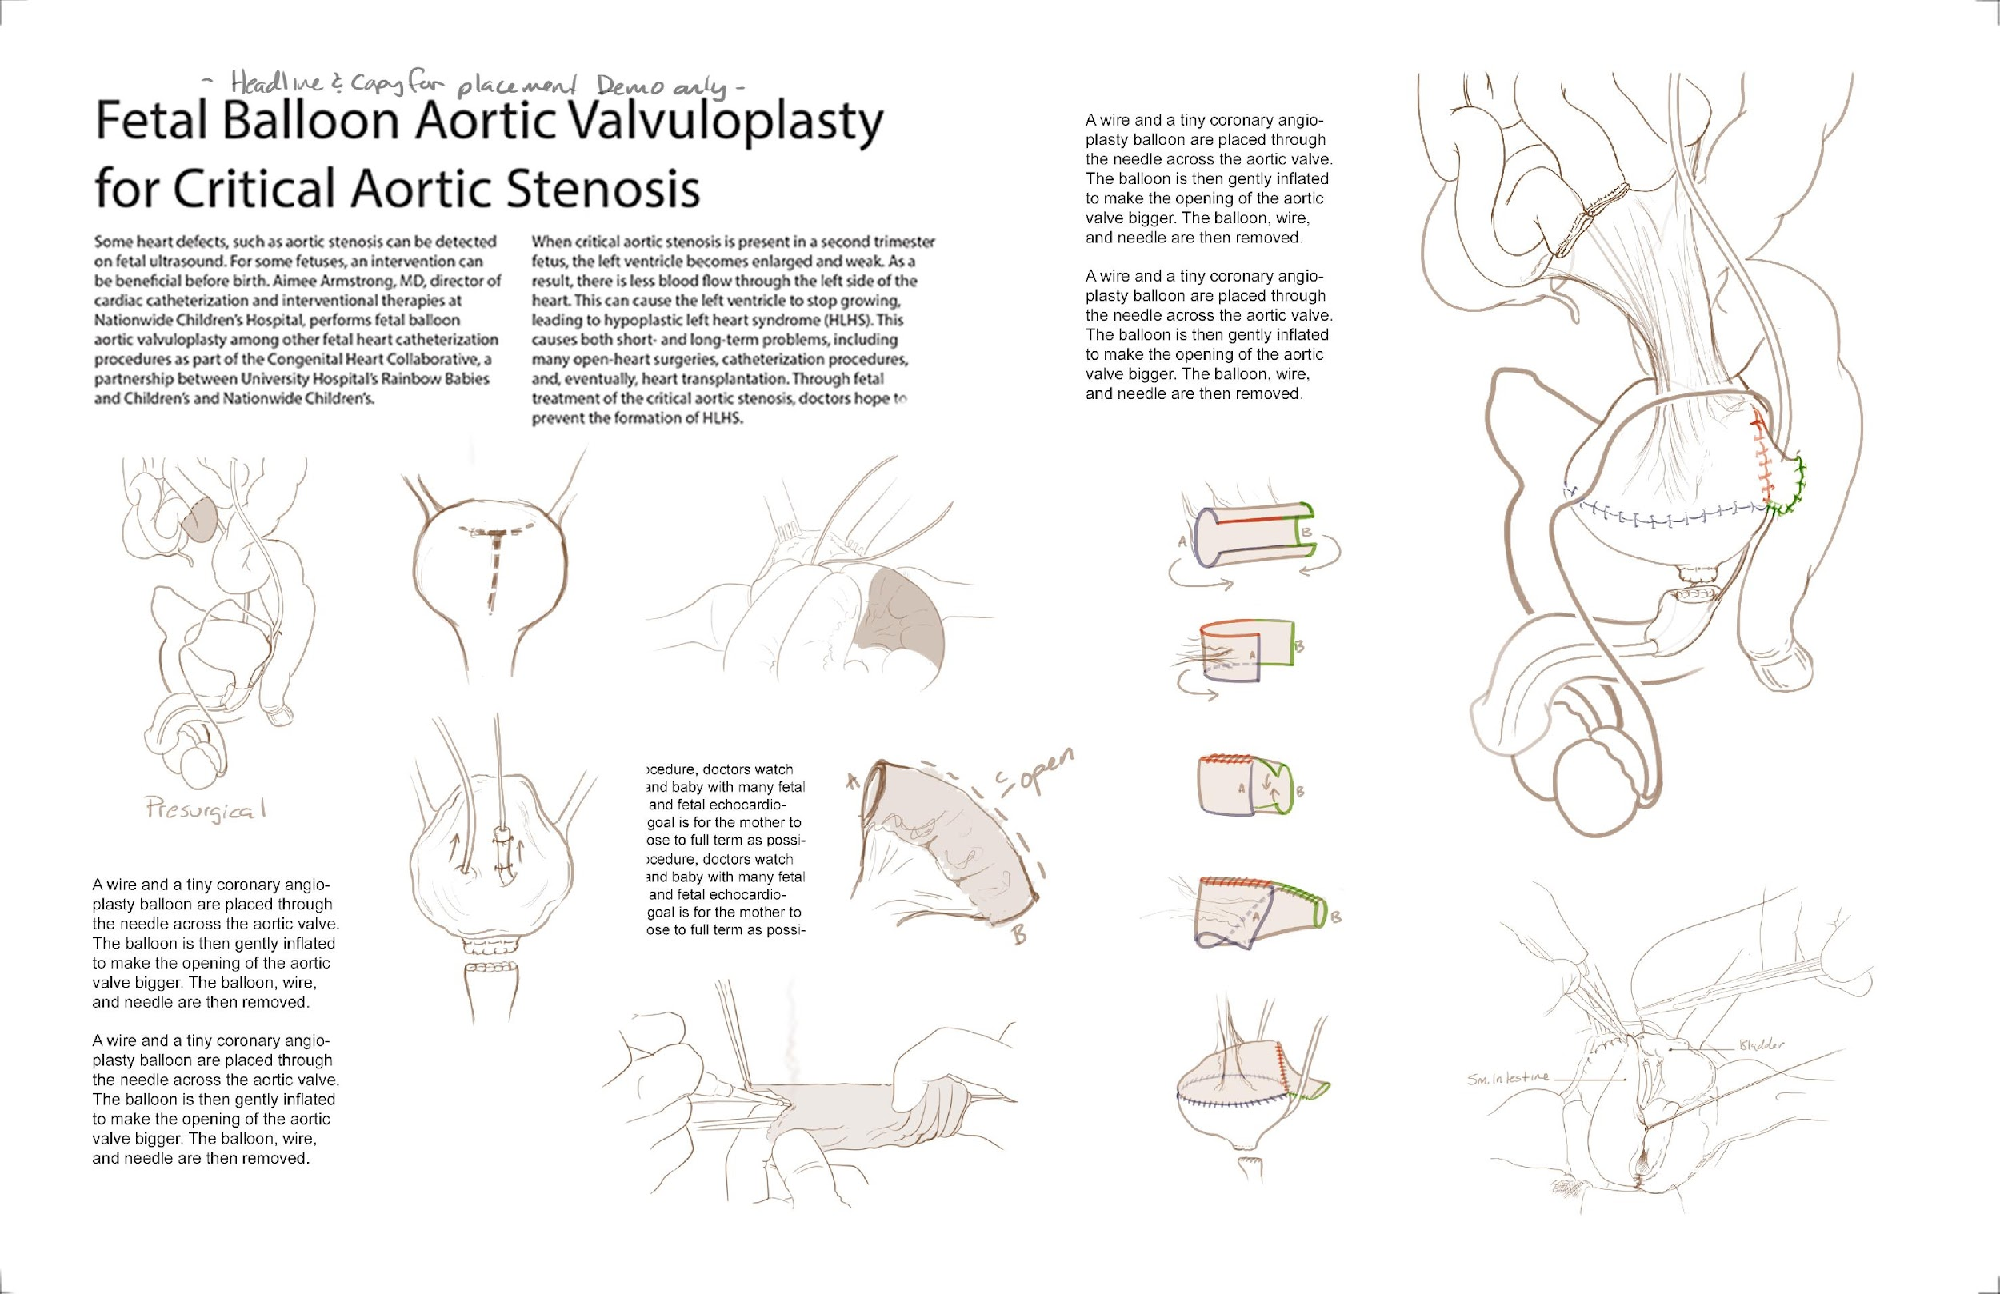
PROJECT OVERVIEW
Rectal Diversion and Bladder Exstrophy – Doctor Rama Jayanthi, Nationwide Children’s Hospital
INITIAL MEETING
ASSET REVIEW
PROPOSAL/CONTRACT
PRELIMINARY SKETCH
REVISION MEETING
SECOND DRAFT
REVISION MEETING
FINAL LINE
FINAL ILUSTRATION

Slide 17
INITIAL MEETING

Slide 18
PROJECT OVERVIEW
Rectal Diversion and Bladder Exstrophy – Doctor Rama Jayanthi, Nationwide Children’s Hospital
INITIAL MEETING
ASSET REVIEW
PROPOSAL/CONTRACT
PRELIMINARY SKETCH
REVISION MEETING
SECOND DRAFT
REVISION MEETING
FINAL LINE
FINAL ILUSTRATION

Slide 19
ASSET REVIEW

Slide 20
PROJECT OVERVIEW
Rectal Diversion and Bladder Exstrophy – Doctor Rama Jayanthi, Nationwide Children’s Hospital
INITIAL MEETING
ASSET REVIEW
PROPOSAL/CONTRACT
PRELIMINARY SKETCH
REVISION MEETING
SECOND DRAFT
REVISION MEETING
FINAL LINE
FINAL ILUSTRATION

Slide 21
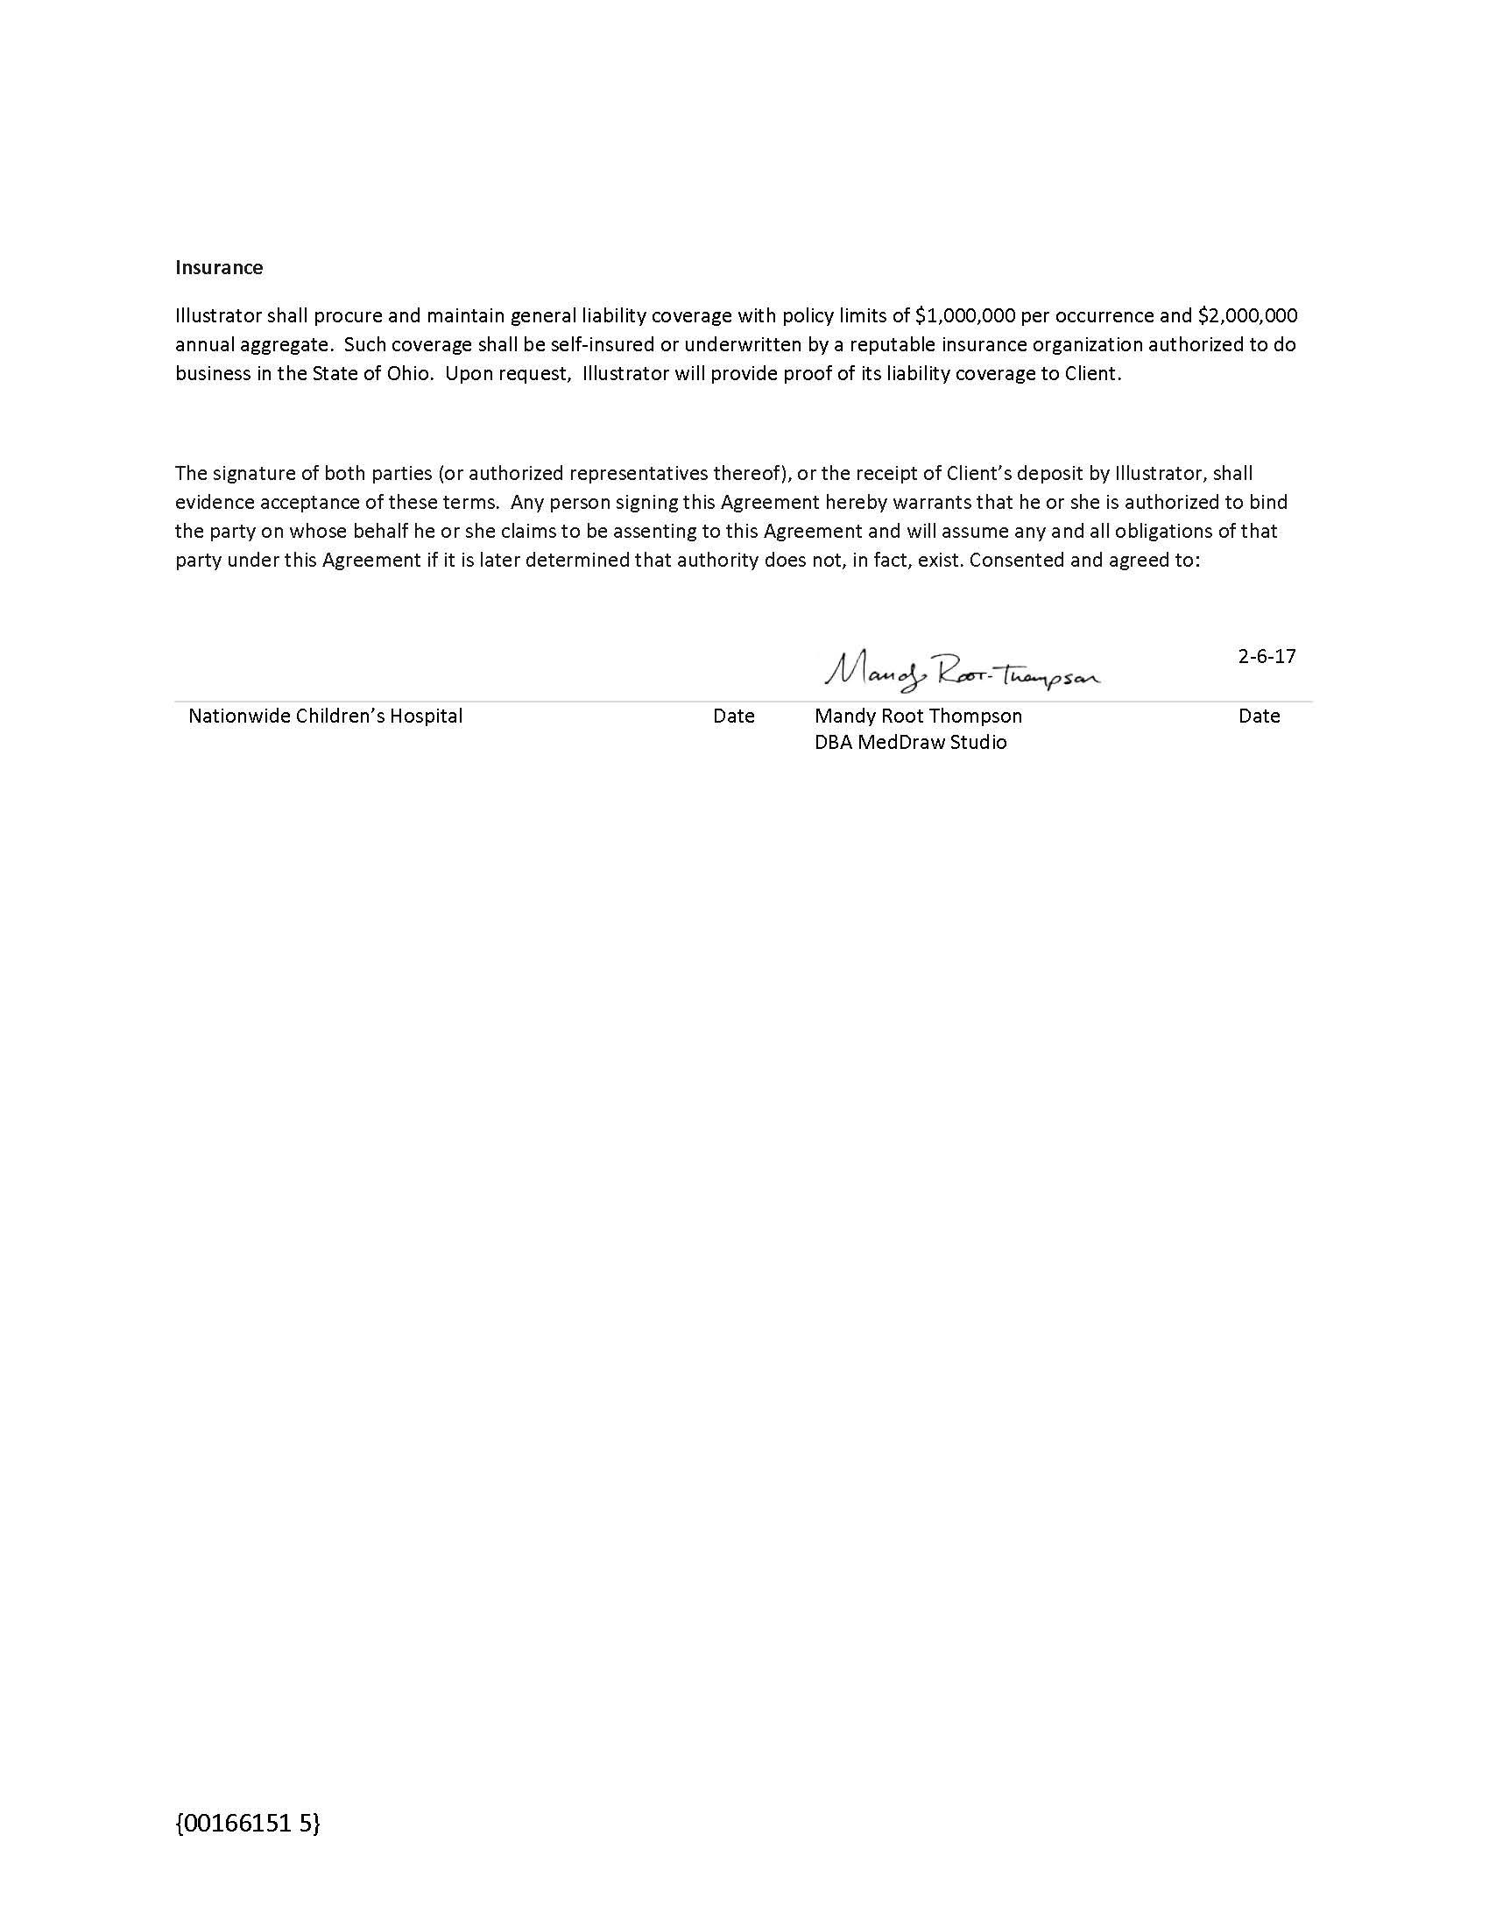
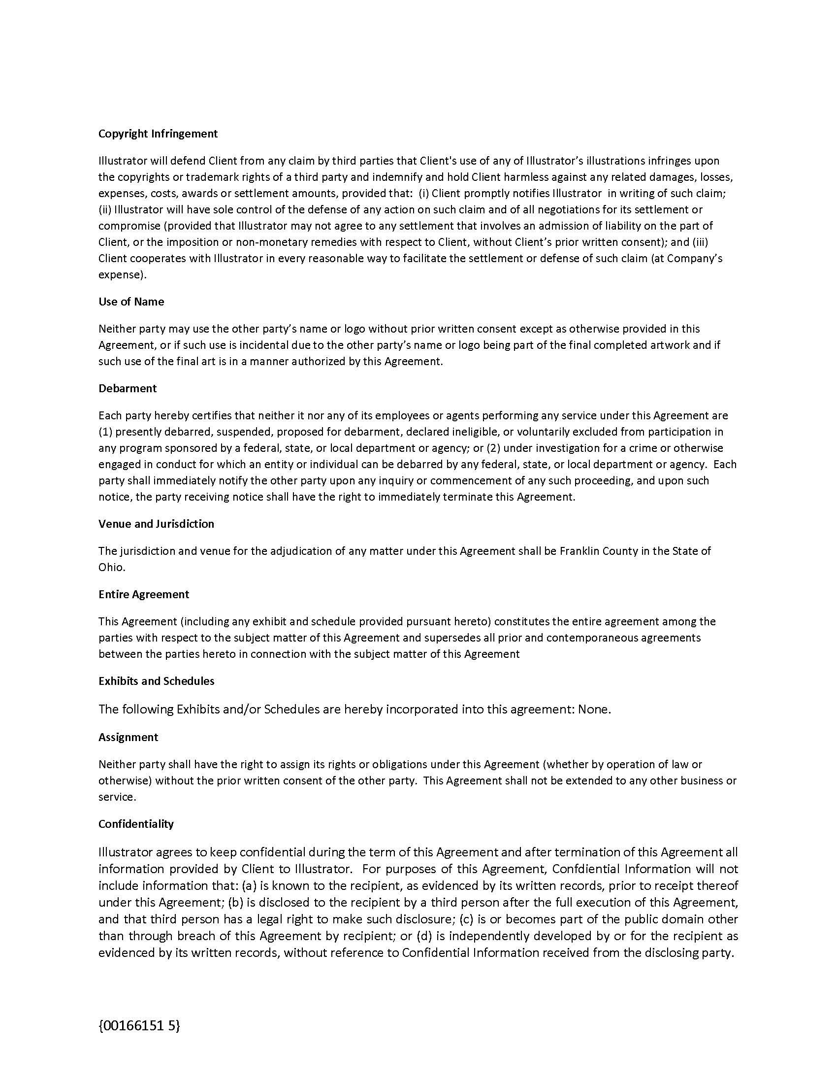
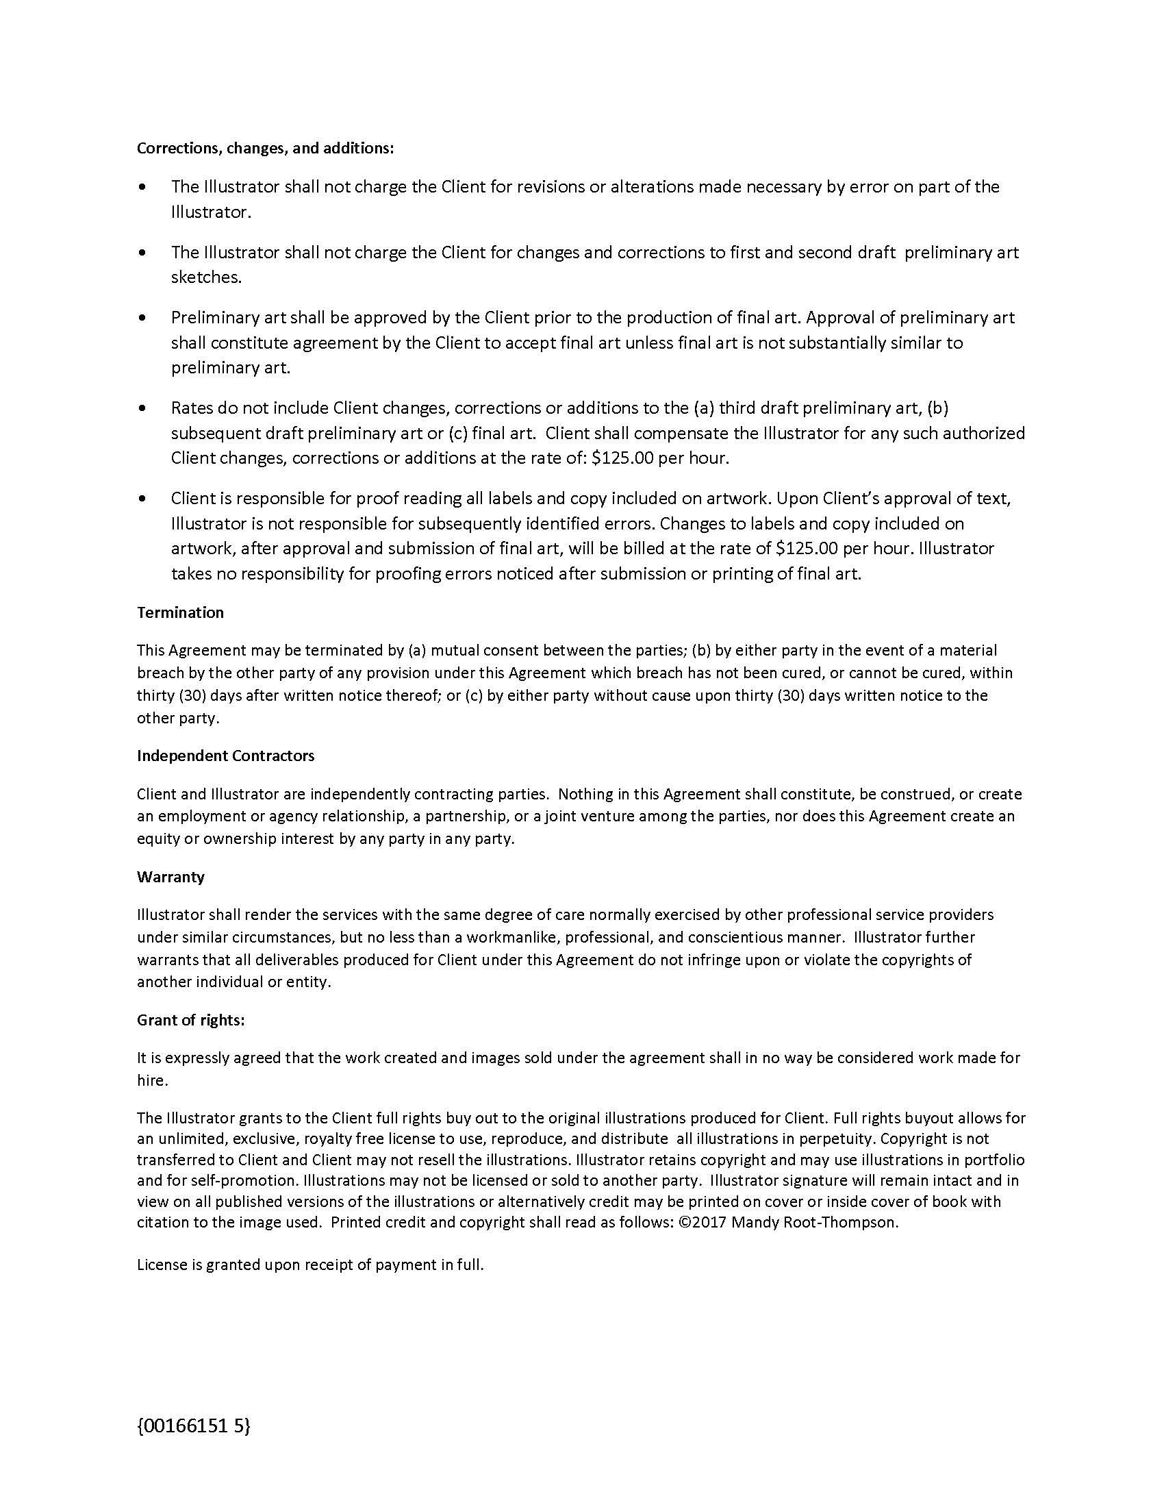
PROPOSAL/CONTRACT

Slide 22
PROJECT OVERVIEW
Rectal Diversion and Bladder Exstrophy – Doctor Rama Jayanthi, Nationwide Children’s Hospital
INITIAL MEETING
ASSET REVIEW
PROPOSAL/CONTRACT
PRELIMINARY SKETCH
REVISION MEETING
SECOND DRAFT
REVISION MEETING
FINAL LINE
FINAL ILUSTRATION

Slide 23
PRELIMINARY SKETCH

Slide 24
PROJECT OVERVIEW
Rectal Diversion and Bladder Exstrophy – Doctor Rama Jayanthi, Nationwide Children’s Hospital
INITIAL MEETING
ASSET REVIEW
PROPOSAL/CONTRACT
PRELIMINARY SKETCH
REVISION MEETING
SECOND DRAFT
REVISION MEETING
FINAL LINE
FINAL ILUSTRATION

Slide 25
1ST REVISION MEETING

Slide 26
PROJECT OVERVIEW
Rectal Diversion and Bladder Exstrophy – Doctor Rama Jayanthi, Nationwide Children’s Hospital
INITIAL MEETING
ASSET REVIEW
PROPOSAL/CONTRACT
PRELIMINARY SKETCH
REVISION MEETING
SECOND DRAFT
REVISION MEETING
FINAL LINE
FINAL ILUSTRATION

Slide 27
2ND DRAFT

Slide 28
PROJECT OVERVIEW
Rectal Diversion and Bladder Exstrophy – Doctor Rama Jayanthi, Nationwide Children’s Hospital
INITIAL MEETING
ASSET REVIEW
PROPOSAL/CONTRACT
PRELIMINARY SKETCH
REVISION MEETING
SECOND DRAFT
REVISION MEETING
FINAL LINE
FINAL ILUSTRATION

Slide 29
2ND REVISION MEETING

Slide 30
PROJECT OVERVIEW
Rectal Diversion and Bladder Exstrophy – Doctor Rama Jayanthi, Nationwide Children’s Hospital
INITIAL MEETING
ASSET REVIEW
PROPOSAL/CONTRACT
PRELIMINARY SKETCH
REVISION MEETING
SECOND DRAFT
REVISION MEETING
FINAL LINE
FINAL ILUSTRATION

Slide 31
FINAL LINE DRAWING FOR REVIEW

Slide 32
PROJECT OVERVIEW
Rectal Diversion and Bladder Exstrophy – Doctor Rama Jayanthi, Nationwide Children’s Hospital
INITIAL MEETING
ASSET REVIEW
PROPOSAL/CONTRACT
PRELIMINARY SKETCH
REVISION MEETING
SECOND DRAFT
REVISION MEETING
FINAL LINE
FINAL ILUSTRATION

Slide 33
FINAL FULL COLOR ILLUSTRATION

Slide 34
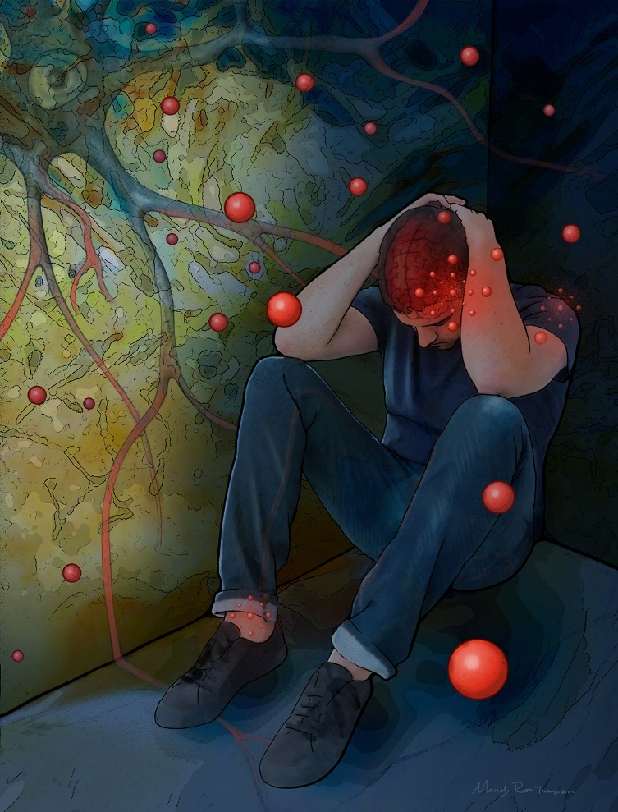
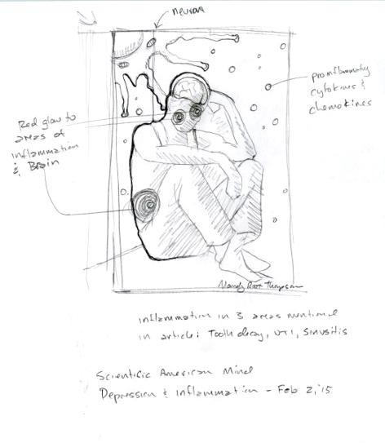
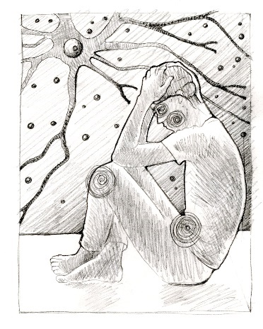
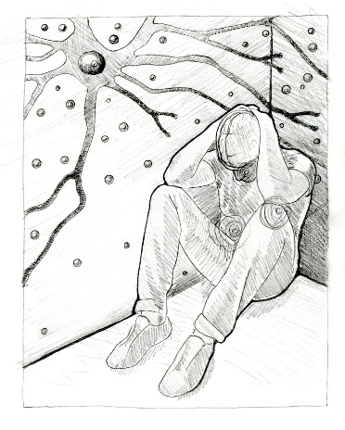
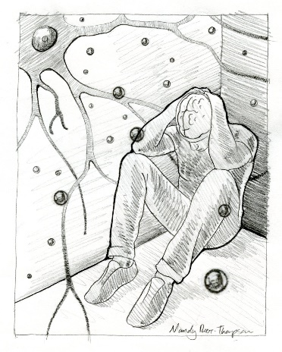

Slide 35
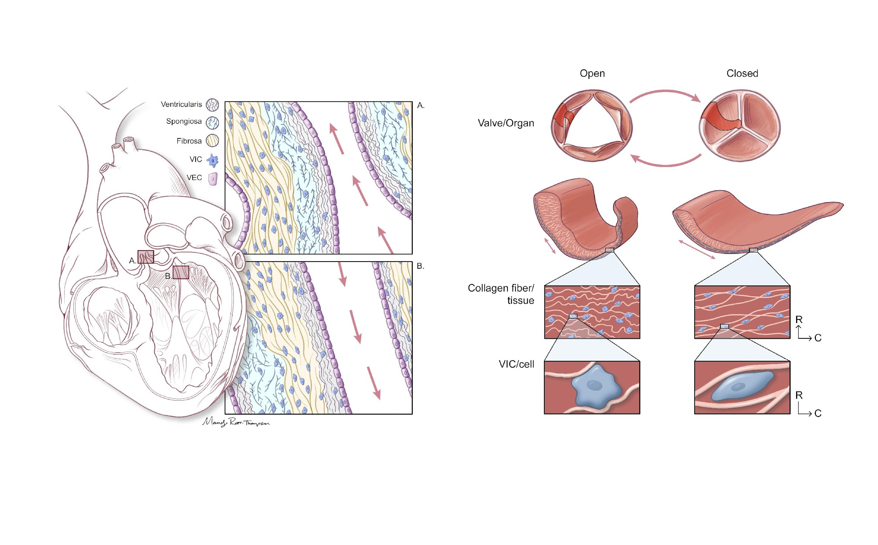
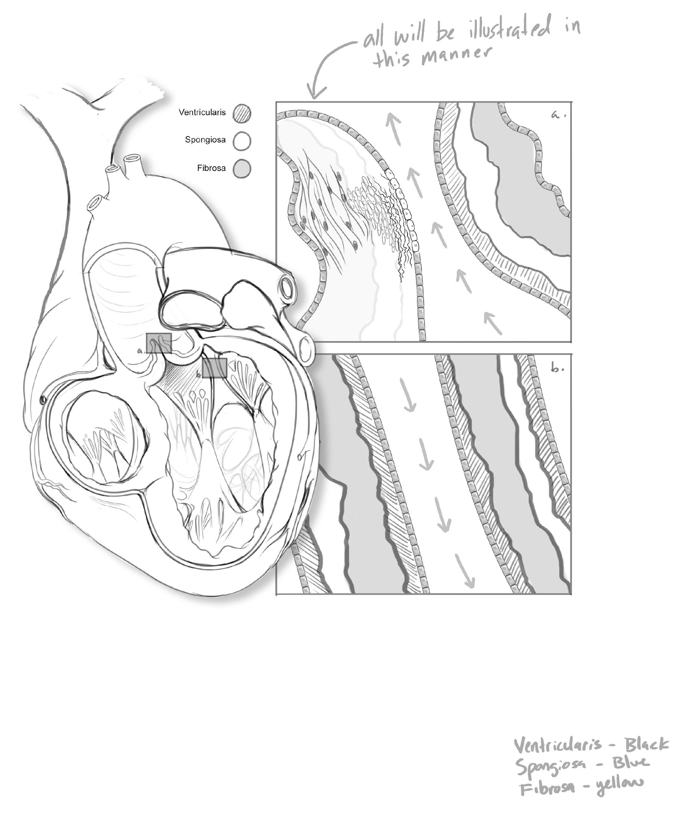

Slide 36
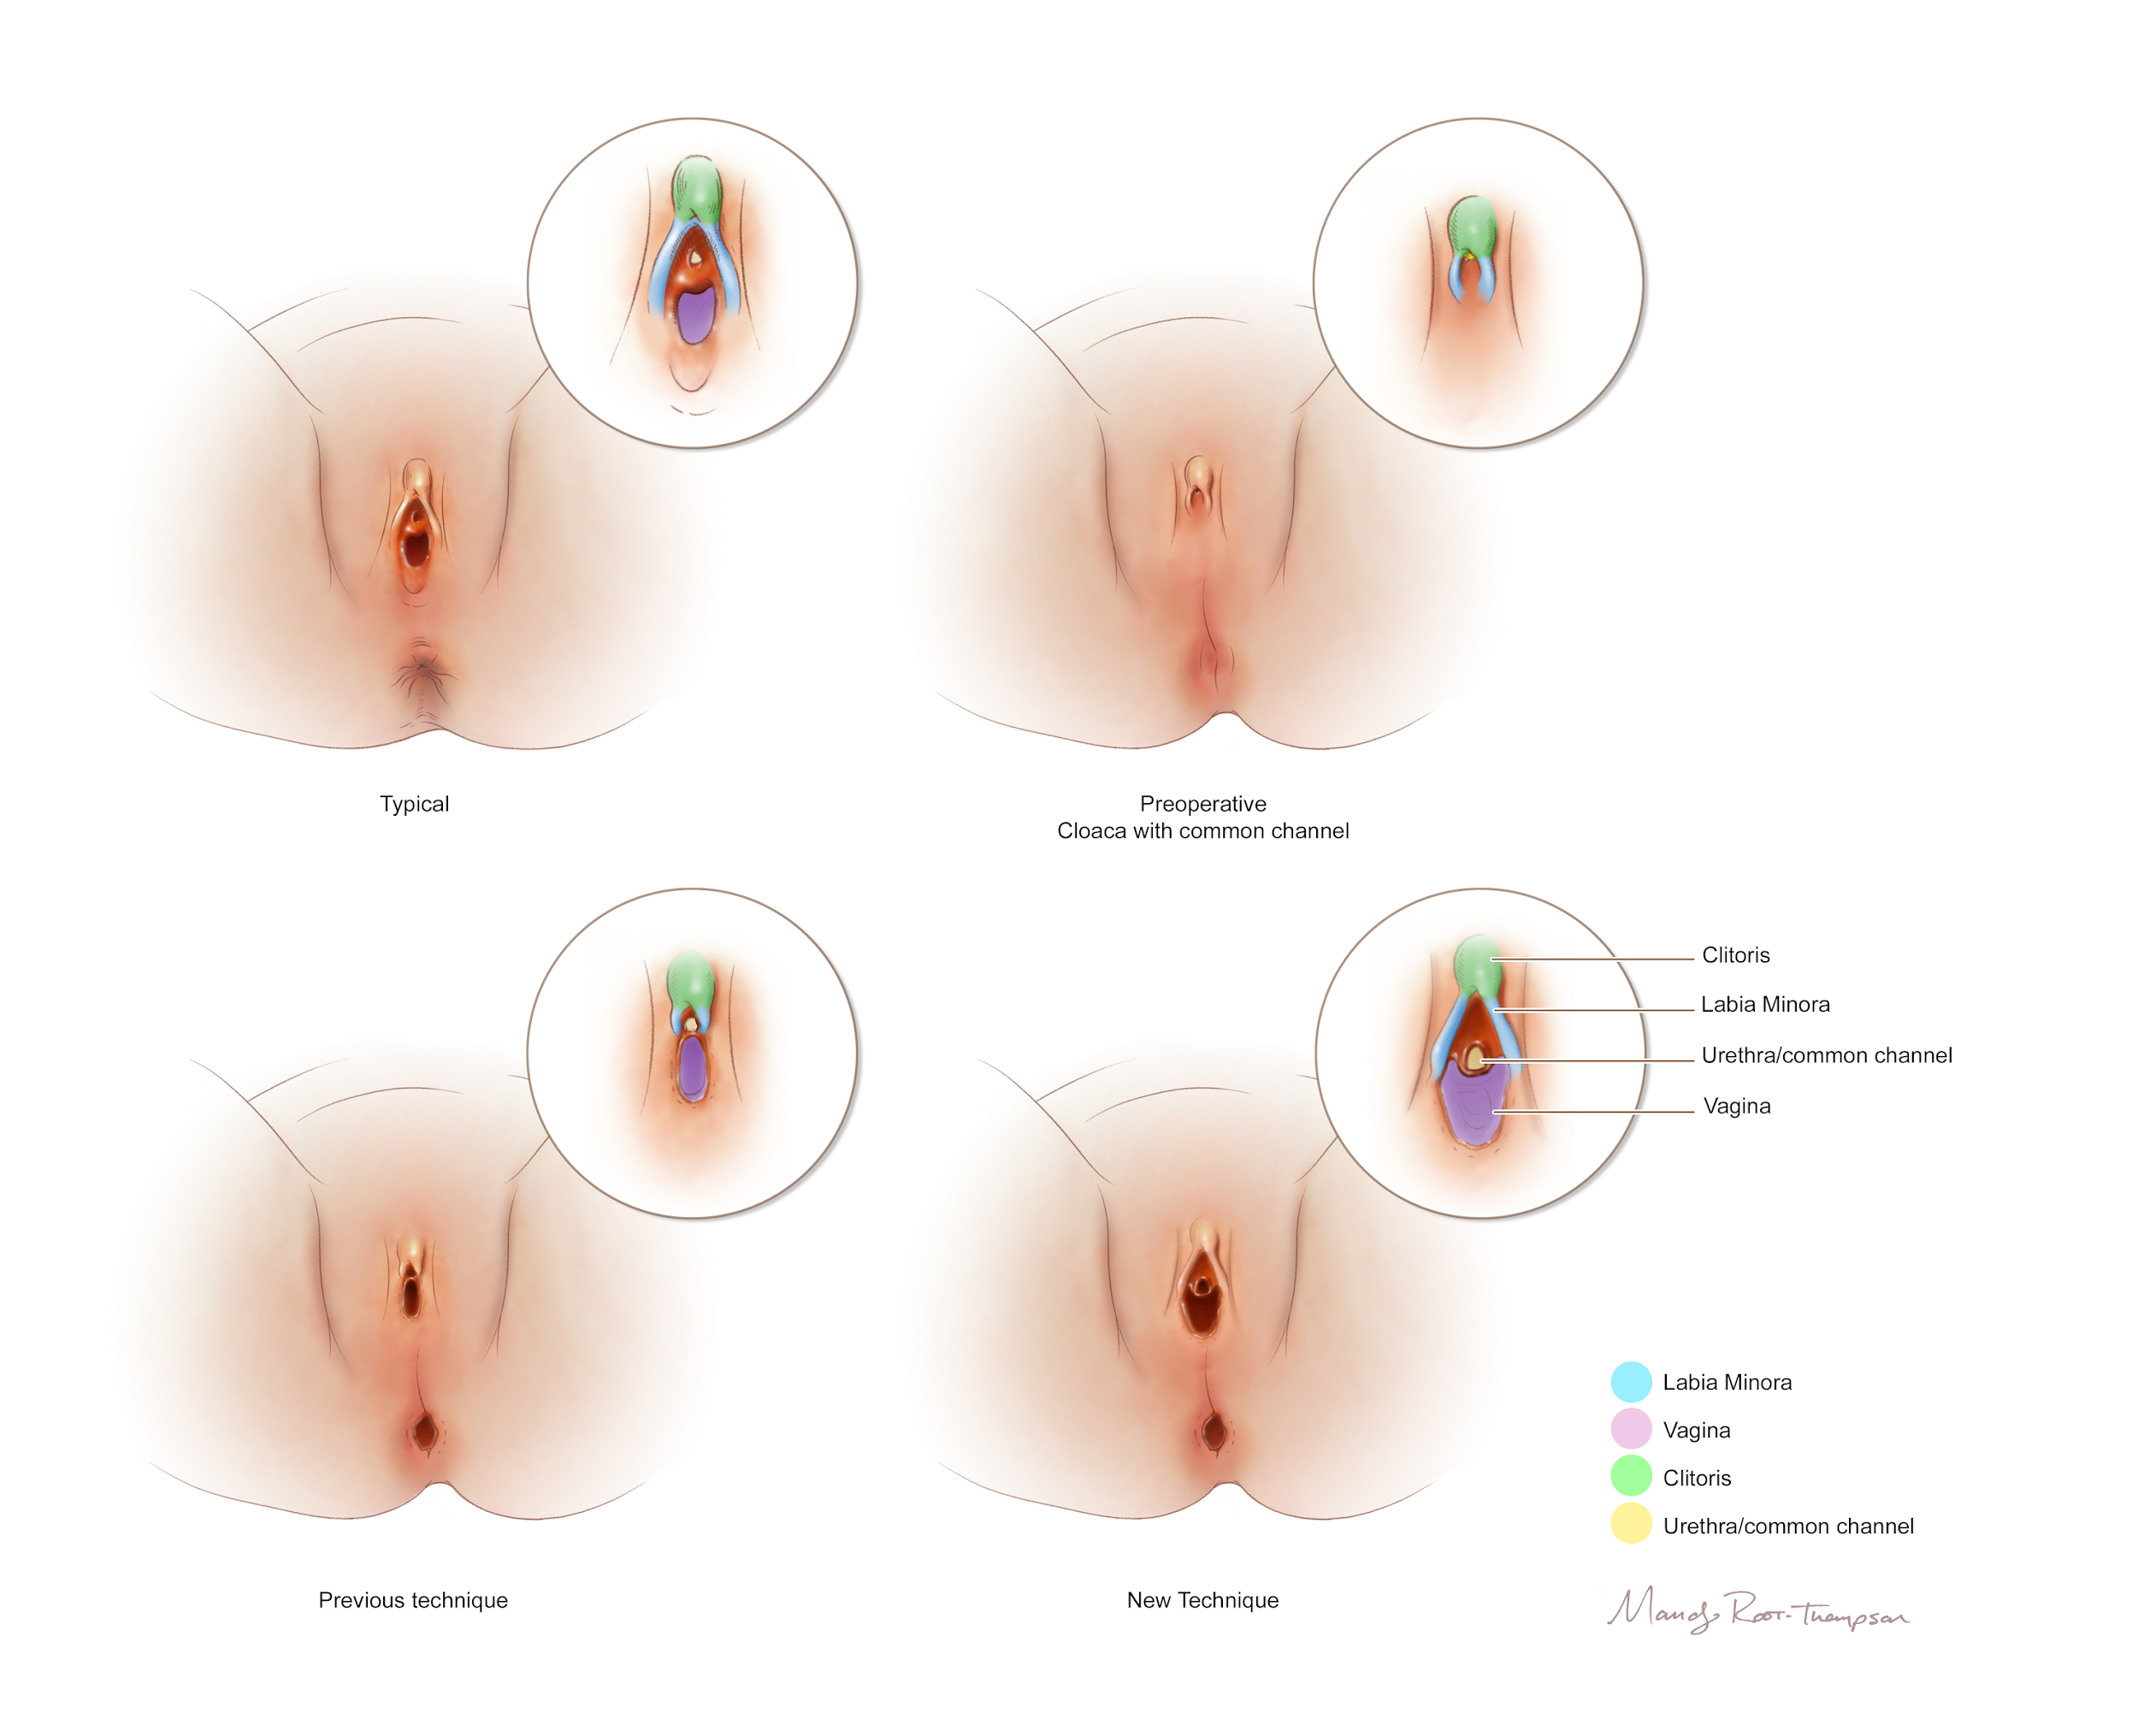
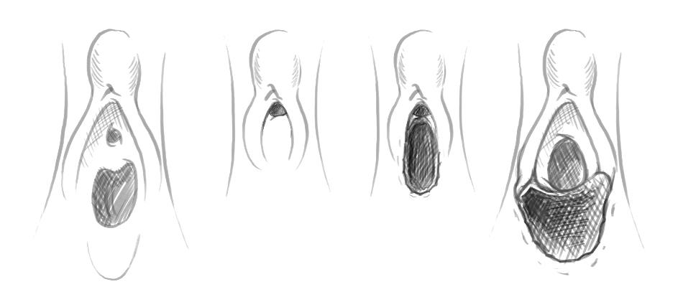




Slide 37



Slide 38



Slide 39
GOOD FENCES MAKE
GOOD NEIGHBOURS
What illustrators want you to understand about copyright and contracts

Slide 40
COPYRIGHT AND CONTRACTS
COPYRIGHT
USAGE RIGHTS
FAIR USE
Copyright is the exclusive legal right, given to an individual to edit, print, sell, publish, distribute, etc. As soon as an illustrator creates a drawing, they automatically own the copyright to that image.
Usage rights are rights granted to an individual by an artist to use something for a specific purpose and for a particular period. This can vary in so many ways.
Fair use is the right to use a copyrighted work under certain conditions without permission of the copyright owner.
Uses made at or by a nonprofit educational institution may be deemed commercial if they are profit-making.

Slide 41
USAGE RIGHTS
One-time Print Use
the limited right to reproduce an image only one time in printed form
Online Rights
the limited right to use the illustration in the Internet edition of the publication, but only to accompany the article or text it supports in the original print edition.
Unlimited, Nonexclusive
a grant of rights that permits the buyer use of an image or work across all media types and parameters. A nonexclusive grant does not prevent the illustrator from granting the same rights to other buyers.
Unlimited, Exclusive
a grant of rights that permits the buyer use of an image or work across all media types and parameters. An exclusive grant allows the artwork to be used only by the one buyer. Unlimited exclusive rights may be broad or specifically limited to a media, industry, territory, or time period.
Transfer of Copyright
an assignment of copyright ownership in a work from the owner to another party. A valid transfer must be contracted in writing and signed by the owner.
Notes:
One-time Print Use: the limited right to reproduce an image only one time in
printed form (paper and ink) in North America (English language). Includes the
right to use the illustration at the same or reduced size on the contents page
and the right to use the illustration in promotion of the publication, but only in
the context of the original printed page.
• Online Rights: the limited right to use the illustration in the Internet edition of
the publication, but only to accompany the article or text it supports in the
original print edition.
• Unlimited, Nonexclusive: a grant of rights that permits the buyer use of an
image or work across all media types and parameters. A nonexclusive grant
does not prevent the illustrator from granting the same rights to other buyers.
Unlimited nonexclusive rights may be broad or specifically limited to a media,
industry, territory, or time period.
• Unlimited, Exclusive: a grant of rights that permits the buyer use of an image
or work across all media types and parameters. An exclusive grant allows the
artwork to be used only by the one buyer. Unlimited exclusive rights may be
broad or specifically limited to a media, industry, territory, or time period.
• Transfer of Copyright: an assignment of copyright ownership in a work from
the owner to another party. A valid transfer must be contracted in writing and
signed by the owner.

Slide 42
WHO OWNS THE COPYRIGHT?
Unless you specifically purchase the copyright, the artist owns it.
Medical illustrators' control who can reproduce their artwork.
Under U.S. and international copyright laws, ownership of creative works is the property of the author (illustrator) from the moment it is created in a tangible form.
What about journals that require full usage rights?
If you want figures prepared for an open access article, tell the medical illustrator in advance so that an appropriate fee and license can be prepared for this special circumstance.
Exclusive unlimited
A grant of rights that permits the buyer use of an image or work across all media types and parameters. An exclusive grant allows the artwork to be used only by the one buyer.
Artist still retains copyright of the artwork

Slide 43

COMMUNICATION IS KEY
Copyright section referenced from: Association of Medical Illustrators. Client Guide to Working with a Medical Illustrator.

Slide 44


  THANK YOU!
  Mandy Root-Thompson
  MS, CMI, FAMI
  www.MedDrawStudio.com
  mandy@meddrawstudio.com
  Email to receive a sample book!

